Slide 1
Workshop
“Bringing GEOSS Services into practice”
Lacroix P., Guigoz Y., Ray N., Giuliani G., Bigagli L., de Bono A.

Slide 2
Sharing Geospatial Data
Outline
Introduction to geospatial data
Current situation
Solutions

Slide 3

Sharing Geospatial Data
EARTH SYSTEM:
COMPLEX
MULTIDIMENSIONAL
INTERDEPENDANT
CHANGING
Notes:
If we consider our planet, The Earth system is something:
- complex
- multidimensional (made of many systems)
- highly interdependent (interdependant)
- dynamic, changing, evolving (spatial +temporal scales)

Slide 4
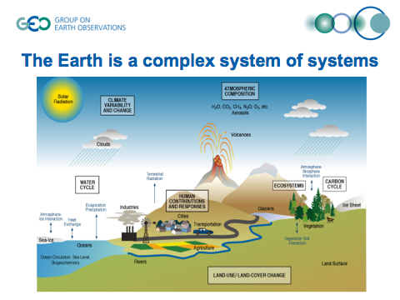
Sharing Geospatial Data
Notes:
It is a system of several interconnected systems
Atmosphere
Water
Land
=> intterconnected

Slide 5
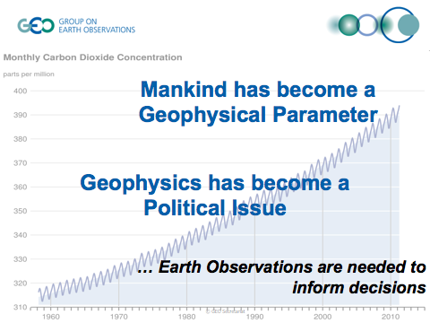
Sharing Geospatial Data
Notes:
read

Slide 6

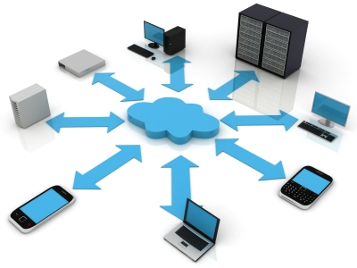
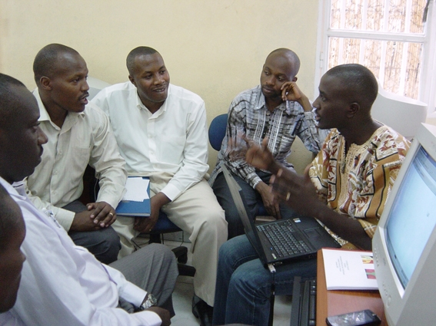
OBSERVE
SHARE
INFORM
Notes:
In order to obtain informed decision,
the traditional scientific way to proceed is the following:
We OBSERVE a phenomenon that we measure by collecting data and analyzing it
We SHARE the observation’s results
Keeping in mind that we want to INFORM others (scientific community, general public, …) to participate to the improvement of global knowledge

Slide 7
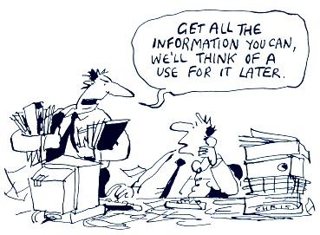
One dataset for many users
Many datasets for one user
Notes:
Data obtained can be useful to many users, not only for us
in fact one dataset can be useful to many people
and one person needs many and various datasets

Slide 8

Data are the fuel for scientific analysis and decision-making
Notes:
- Data are the fuel to make scientific analysis and to support decision making process.
!!!BUT More than 50% of the time of scientists and decisions-makers is spent in searching data and information.
=> This is a waste of time, that prevents them from concentrating on analyzing data and taking good informed decisions.

Slide 9
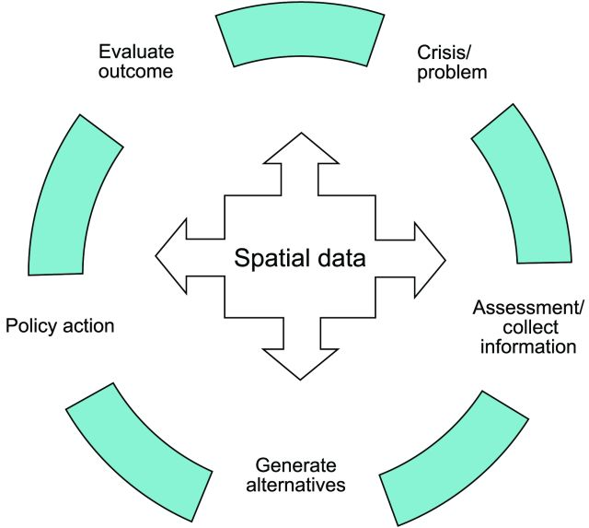
Spatial information affects
60 - 80% of all decisions
Notes:
Various authors agree that the vast majority of the decisions that are taken by politicians are dependent in a way or another by the spatial information
=> 60-80% of all decisions depend on spatial information

Slide 10

Agenda 21 addresses the need for information, development of appropriate databases and exchange of information as conditions for creating the basis for sustainable development.
Notes:
This major role of spatial information has been clearly stated during the 1992 Earth Summit in Rio, when a resolution establishing the Agenda 21 voluntary action plan has been issued
the Agenda21 is a plan of actions to be performed at all scales (global, national, local) and in each domain where human activity has an influence on the environment
=> By facilitating efficient global and local access, exchange and utilization of geospatial data, we can enhance decision-making at all levels of societies, for the benefit of mankind and the environment.

Slide 11
Turning raw data into understandable information
Gore (1998)
Notes:
In 1998, Al Gore was already saying that it was a necessity to make speak these data by turning raw data into information understandable by everyone

Slide 12

What is the real situation?
Notes:
- But what is the real situation when we want to look for environmental data nowadays?

Slide 13
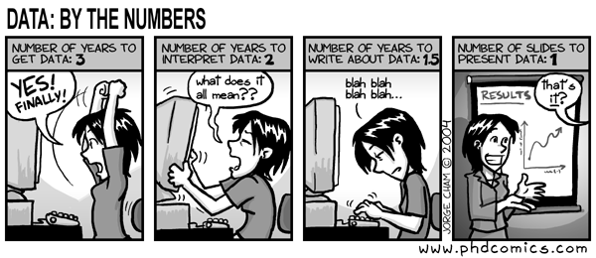
Finding environmental data is difficult.
Notes:
- Finding environmental data is something difficult
Estimated that in Europe 50% of users time spent in looking for data and make them compatible in order to be able to use them

Slide 14
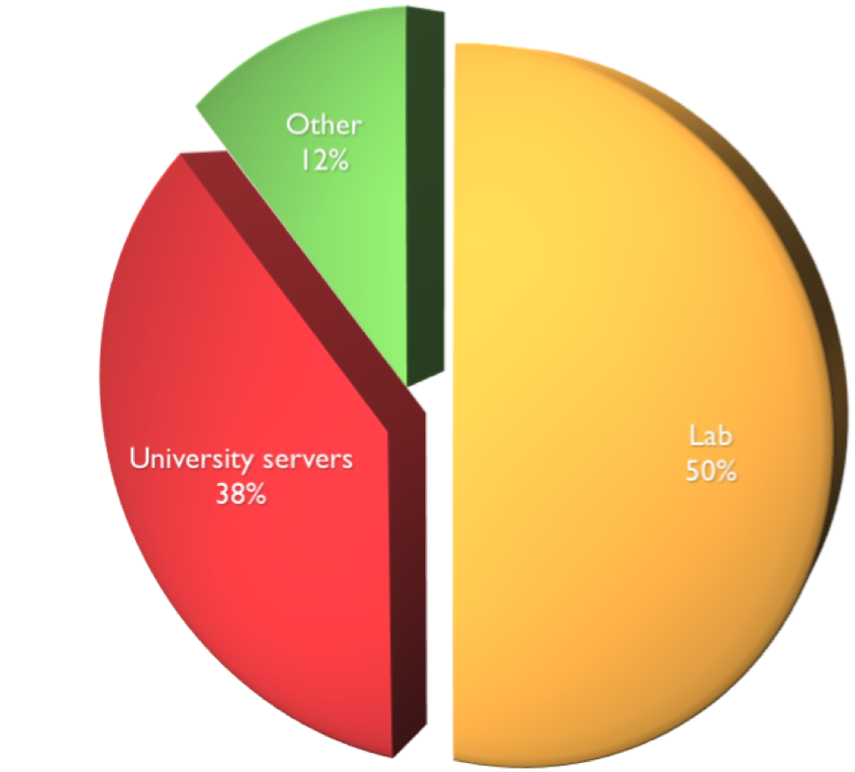
Where do you archive most of the data generated in your lab or your research?
Science Staff (2011)
Notes:
This can be explained by a 2011 survey in which 1700 scientist participated where it was showed that most data (88%) stayed in their lab or on university servers
Data difficult to access , nearly impossible to find for an external person

Slide 15
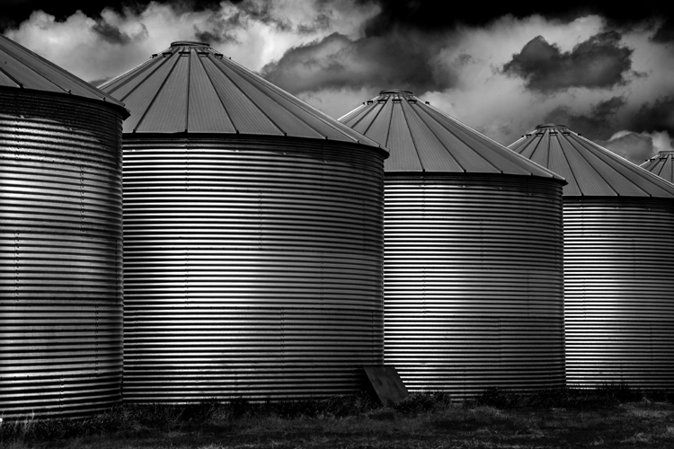
Talking about Landsat... “In spite of the great need for that information, the vast majority of those images have never fired a single neuron in a single human brain. Instead, they are stored in electronic silos of data”
Gore (1998)
Notes:
In short, most data is stored in electronic silos and are never or very rarely used
- Again Al Gore (USA vice-president) was already mentioning this problem about Landsat

Slide 16

Today’s best tool for searching data?
Notes:
Today the best tool to search for data remains Google
but does not really address the needs of the scientific community for working with environmental data
for ex. Impossible to search by time (for ex. All European temperatures may 1992)
improvement with Google Earth or Google Maps but not allow yet to analyze data

Slide 17

Operated in isolation...
Notes:
Often the observation systems are made for a particular objective and hence operated in isolation and rarely compatible

Slide 18

Data are expensive to produce
Notes:
Environmental data are often expensive to produce
ex: sending a satellite to space needs a lot of material, development and implies many people => several millions dollars

Slide 19
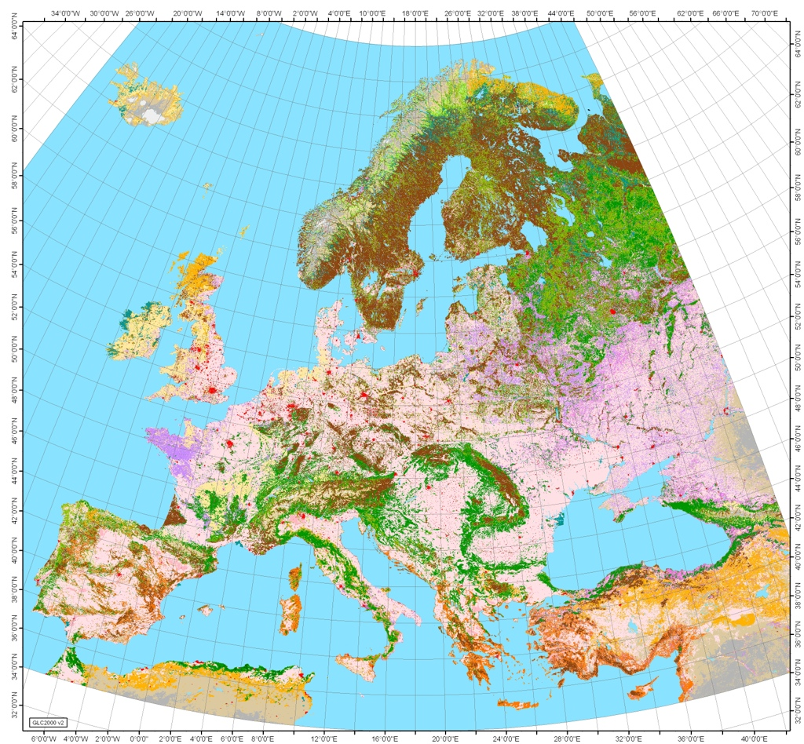
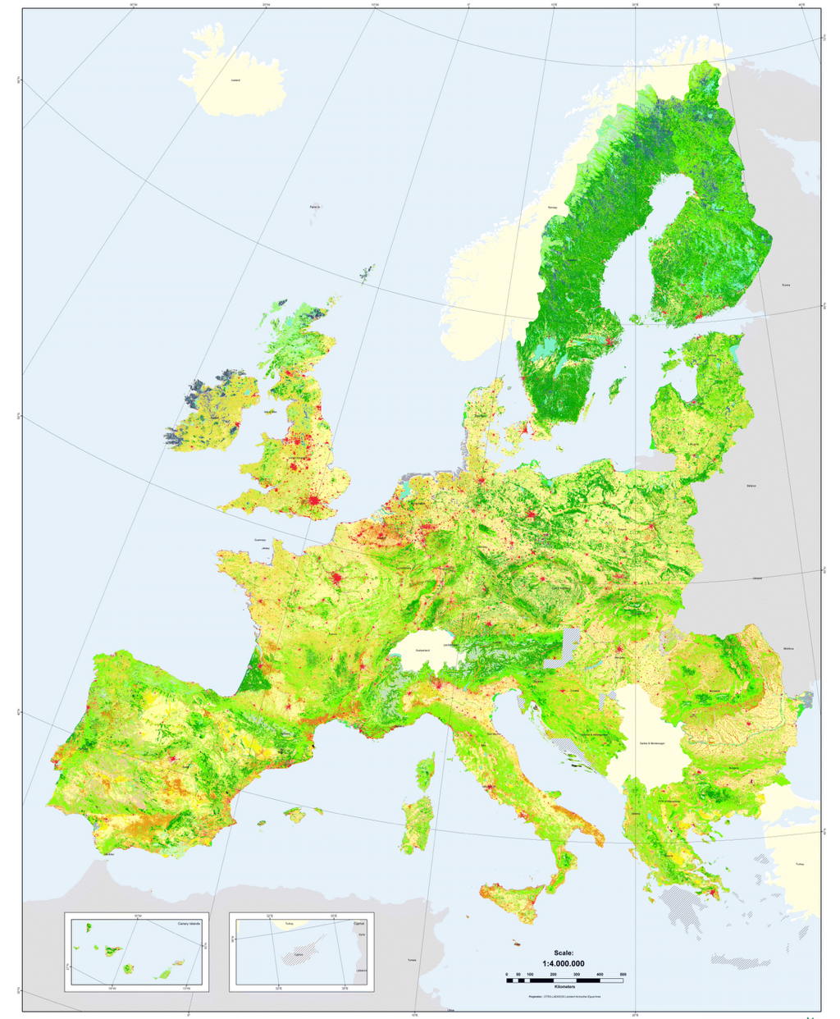
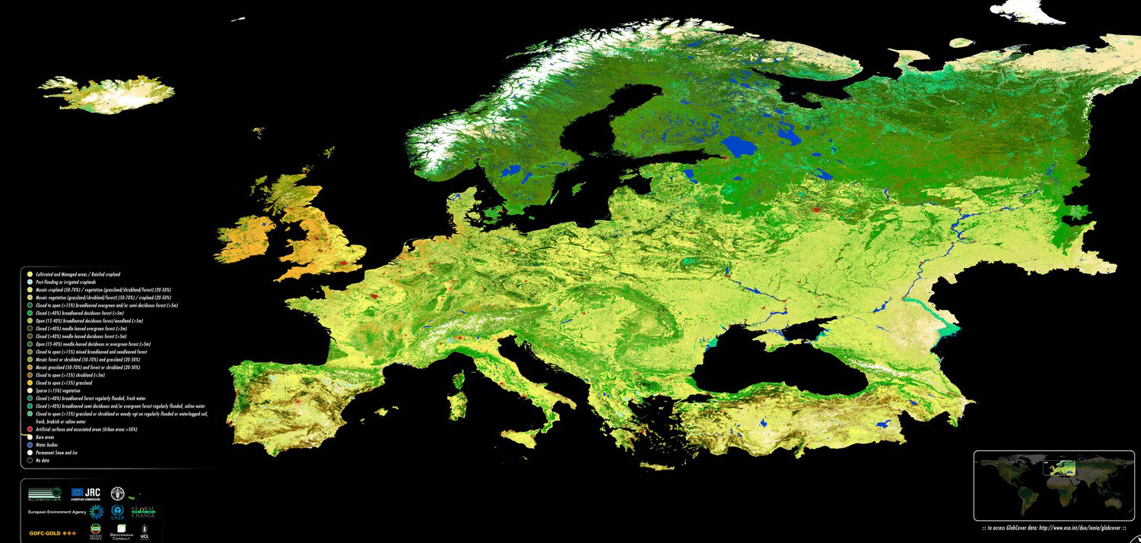
Many “islands” of data of different formats and quality.
GLC2000
CORINE
GLOBCOVER
Notes:
For a same dataset (ex: land cover), data of different quality and format
These 3 datasets are not compatible as can not be integrated or compared as the classification is different
projection and resolution also different
ex: In CORINE, CH + ex-YUG not represented

Slide 20
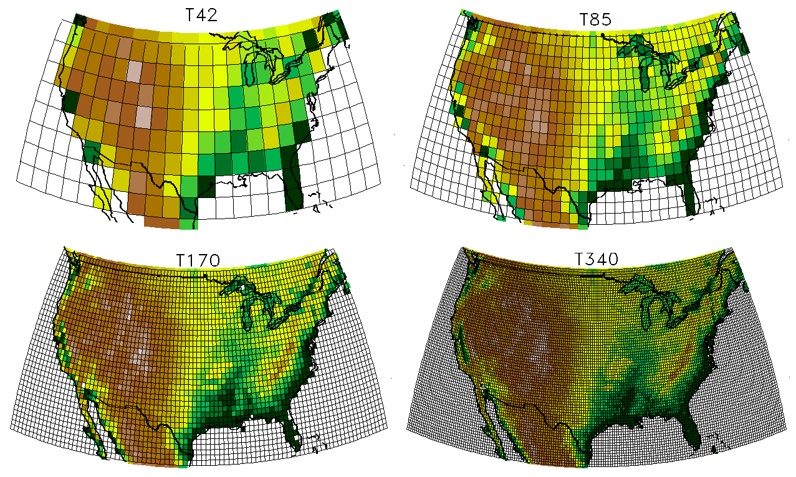
Notes:
Technological progress → resolution of spatial env. Data increase (ex: climatic data) → data more and more accurate and heavy
Need of more and more powerful computers to be analyzed

Slide 21


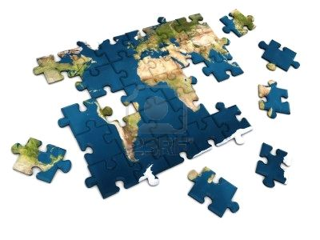


Geospatial data are difficult to integrate
missing documentation
(metadata)
incompatibilities
(formats, models, ...)
data fragmentation
data replication
data policies
Notes:
- In conclusion, geospatial data difficult to integrate because of:
- incompatibilities in terms of formats or models
- lack of metadata (who creates and maintains the data, what resolution, …)
- data is fragmented (electronic silos) and needs to be replicated even if exists already
- data policies (ex: distribution) are often not helping (copyrights, password protection, …)
de politique de distribution, arrangements institutionnels (droits d’auteur, mot de passe,...)
All these elements prevent an efficient use and integration of data => currently difficult to exchange and deliver quality information

Slide 22

Notes:
Can we disseminate data and information in a better and efficient way?

Slide 23
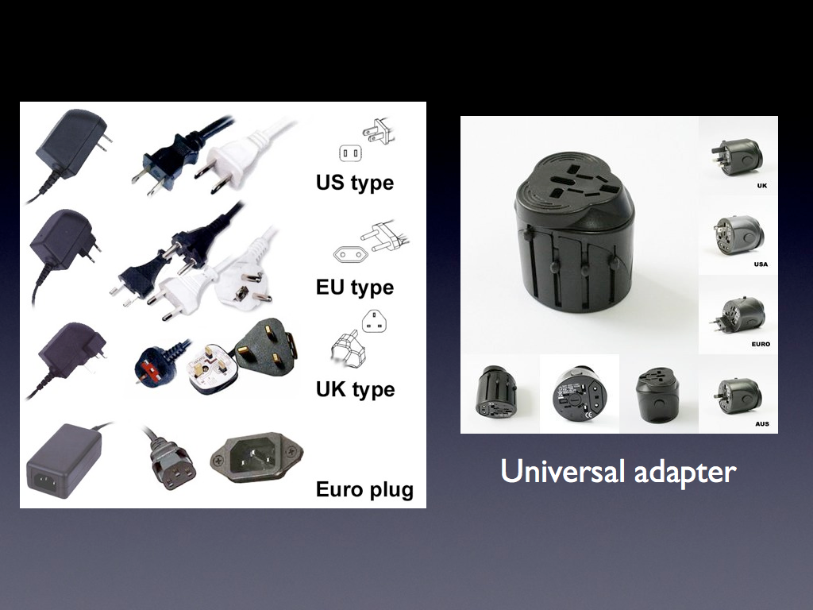
Notes:
We can compare the actual situation with this plugs of many type, all useful and needed but not really compatible
the solution to make them compatible is an universal adapter that will make all of them interoperable

Slide 24

Interoperability
“the ability of two or more systems or components to exchange information and to use the information that has been exchanged”
Notes:
What is interoperability?
it is the capacity to facilitate integration, just like 2 pieces of a puzzle
- Read definition

Slide 25

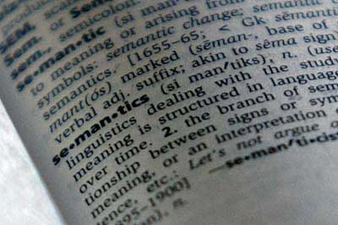


INTEROPERABLE SYSTEM ASPECTS
Technical
Machine to machine communication
Software module interaction
APIs
Formats
Schemas
Semantic
Common understanding
Common concepts, terms, ...
Interdisciplinary special vocabularies
Legal
Digital rights
Ownership
Responsability
Copyright
Human
Cooperation, collaboration
Training
Notes:
- An interoperable system has several facets:
- Of course technical
- semantic (même terminologie)
- legal
- and human: this is the reason why we are here today: to train, to exchange, to collaborate, …

Slide 26

FACTORS FACILITATING INTEROPERABILITY
Metadata
Shared best practices
Standards
Standards
Business models
Copyright
Networks
Authorization
Agreements
Incentives to
cooperate
Policy framework
Infrastructure
Notes:
There are several factors to facilitate interoperability but the most important one = STANDARDS

Slide 27
STANDARDS
“ Reference documents that define characteristics and provide technical specifications to ensure interoperability between various components”
Notes:
STANDARDS = reference documents that define characteristics and provide technical specifications to ensure interoperability between various components

Slide 28
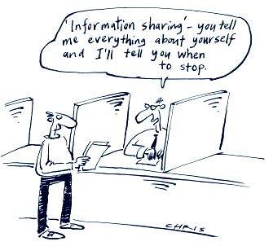
Data can be a shared resource
Notes:
standards make it possible to consider data as a shared resources, that can be useful in several domains and for various communities

Slide 29
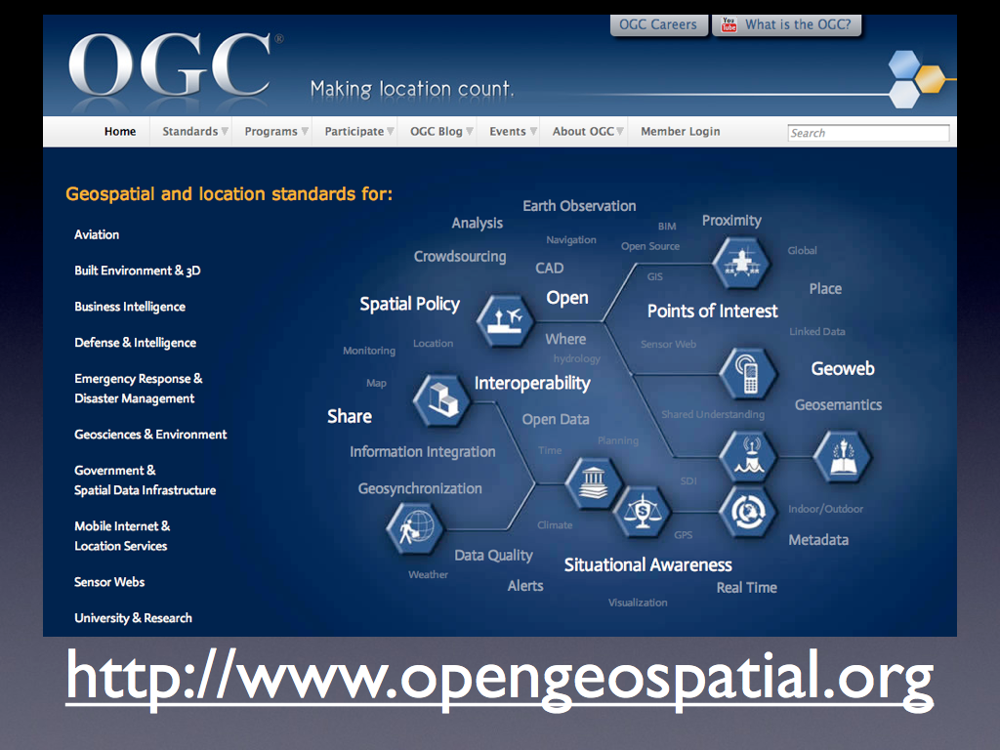
Notes:
One of the most important enablers for interoperability are STANDARDS.
in geomatics there are several organisms responsible for standardisation like ISO, OASIS, W3C but …
The Open Geospatial Consortium (OGC) is the leading organization for geospatial standards and associated services.
OCG works in close collaboration with ISO

Slide 30
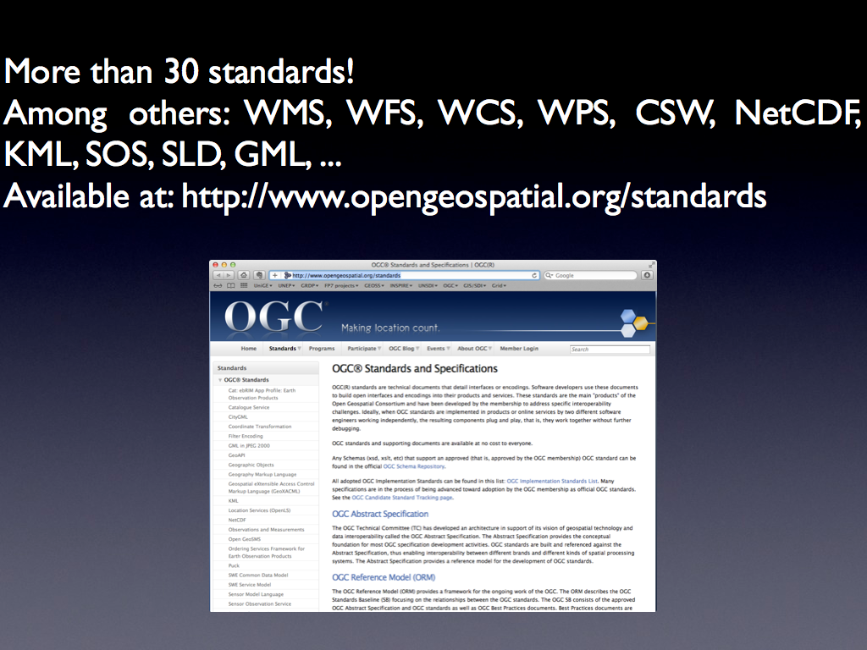
Notes:
OGC provides more than thirty (30) standards for data discovery, visualization, access and processing.
the best known and important ones are for ex: WMS, WFS, WCS, …

Slide 31




Web Mapping Service (WMS)
HTTP protocol for publishing a collection of layers as a map (PNG, JPEG)
Web Feature Service (WFS)
HTTP protocol for publishing feature collections that may be queried and updated by clients (features published as GML,…)
Data
Web Coverage Service (WCS)
HTTP protocol for publishing “coverages” (multi-band raster data)
that can be accessed by clients (GeoTiff, HDF)
Catalog Services for the Web (CS-W)
Defines several web interfaces for data discovery
Metadata
Web Processing Service (WPS)
Defines an interface to share geoprocessing algorithms
Processing
Notes:
data:
WMS: maps as images
WFS: vector (ex: boundaries)
WCS: raster (ex: satellite images
- metadata
Analysis
these are a suite of standards that allow to perform data analyses
you will see them in more detail later with live demo

Slide 32
http://preview.grid.unep.ch:8080/geoserver/wfs?bbox=112.90721 ,-54.75389 ,158.96037 ,-10.1357
&styles=cyclones_style
&request=GetFeature
&version=1.0.0
&typename=preview:cy_intensity
&srs=EPSG:4326
Notes:
- These standards are based on web technologies and allow to distribute data in an interoperable way
- This is called web services
On the screen, example that allows to access to vector data
it is a simple url (just like for accessing a website), with several standardized parameters (style, request, version of the standard, layer name and projection)
this allows to serve a data

Slide 33
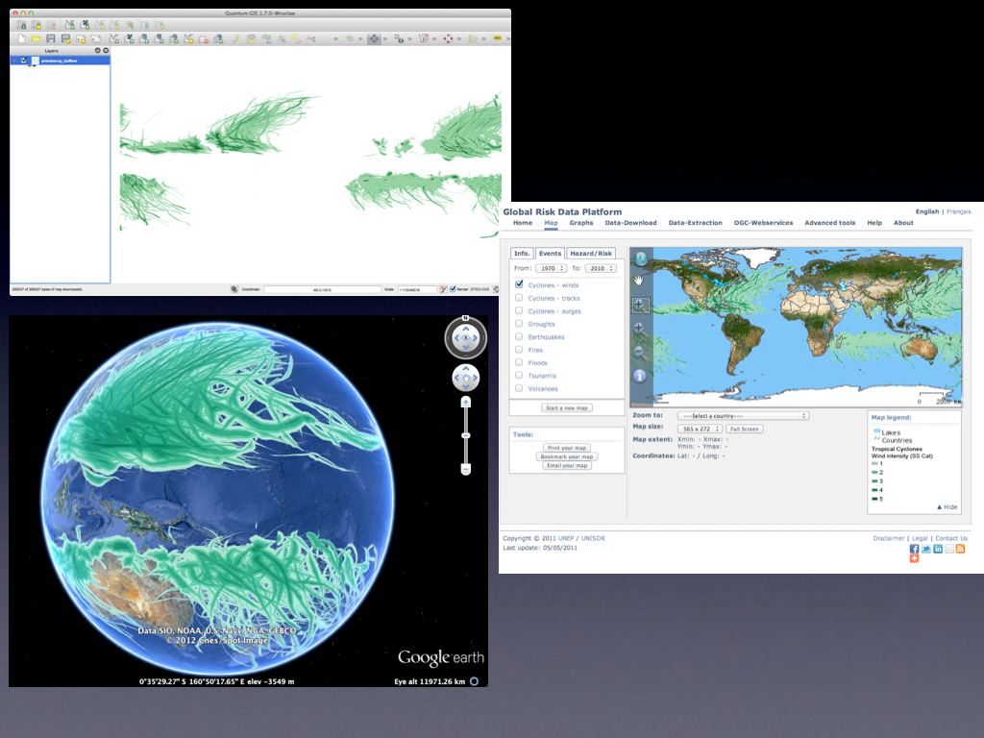
Notes:
- A same data can be displayed in diffrerent client programms such asQGIS, Google Earth and a web platform => added value

Slide 34
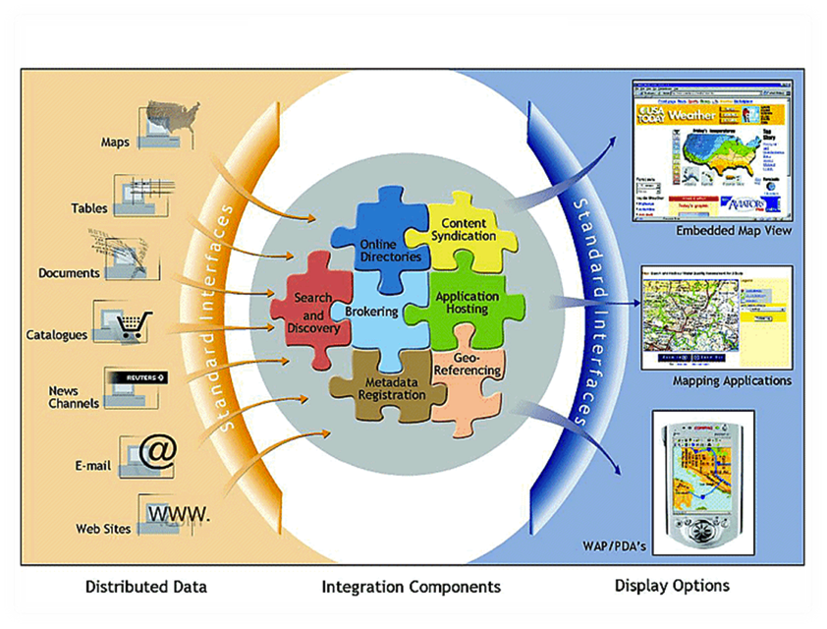
Notes:
The OGC vision is to be able to integrate as best as possible (through standards) heterogeneous data sources and to distribute their content in an interoperable way (also through standards) to various clients (web, desktop applications, smartphones, …)

Slide 35

How to connect distributed & heterogenous data sources?
Notes:
Now we know that it is possible to share data in an interoperable way
But how to connect heterogenous and distributed data sources?

Slide 36
SDI
Notes:
- The answer can be summarized in 3 letters: SDI

Slide 37
Spatial Data Infrastructure
Notes:
Which stands for Spatial Data Infrastructure
A Spatial Data Infrastructure allows to interconnect various data sources

Slide 38

Enabling environment that supports easy access to and utilization of geospatial data.
SDIs are more than just data repositories.
Discovery, visualization, evaluation, and access to geospatial data and information.
Notes:
- An SDI can be seen as an enabling environment that supports an easy access to and utilization of geospatial data.
- It is much more than just data repositories.
- It allows to discover, visualize, evaluate, and access geospatial data and information.
- This is an environment where users can interact continuously with data. The objective is to bring data as close as possible of
the users and answer to their needs.

Slide 39
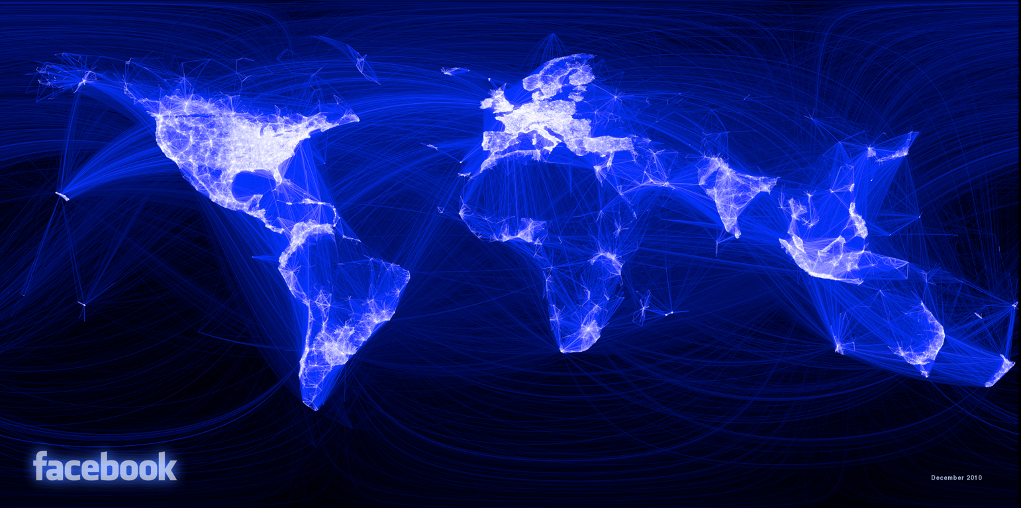
“an umbrella of policies, standards and procedures under which organizations and technologies interact to foster more efficient use, management and production of geospatial data”
GSDI (2004)
Notes:
- A more formal definition is given by the GSDI Association.
- read

Slide 40

Unlock the power of data, information, and services
Notes:
- In short it allows to unlock the power of data, information, and services

Slide 41
DATA
GOVERNANCE
GOVERNANCE
INFRA.
VISION
SKILLS
GOVERNANCE
GOVERNANCE
FUNDS
Notes:
In order to develop a successful SDI, the following components are esential:
To have a vision, an objective to reach to answer users needs
Data
infrastructure for storing data, metadata, the network and the technology
funds as an SDI is not free
skills: people able to manage the various parts of the SDI (ex: IT, GIS, …)
but most of all a GOVERNANCE (policies, standards, institutional arrangements, …) to manage all these components; this is the HUMAN component of SDI
if NO GOVERNANCE => does not work

Slide 42

Maximize the reuse of data.
Analogous to a road, reliable environment allowing the movement of data.
All about reuse: data, capabilities, skills, investments, ...
sharing: data, knowledge, ...
learning from others: collaboration and co-operation.
Working smarter
and not harder
Notes:
The goal of SDI is then to maximize the reuse of data, capacities, investments
can be compared to a road on which data will move efficiently
In short, SDI is about:
read
Goal=work smarter and not harder

Slide 43
STANDARDS
Interoperability:
OGC (WMS, WFS, WCS, CSW)
Guides & specifications:
Internal specifications
Data quality:
Internal specifications
Metadata:
ISO19115/19139 & ISO 19119
DATA
Scale and resolution:
spatial
temporal
POLICIES
Institutional arrangement:
Partnerships
Agreements
Data custodian
Financial support
Capacity building:
Human
Infrastructure
Institutional
Metadata content:
Attributes
PEOPLE
Data providers:
Collaborating centers
Data content:
Attributes
End-users:
BSC & ICPDR,
EG partners
Decision-makers
Governments
Education/Research
Standards:
None
Capture:
Means
Access & use:
Copyright
Pricing
Rights
Environment:
Cultural
Political
Storage:
Database
File system
SDI organization:
Coordination
Working groups
Access:
Geoportal
Web services
Frameworks:
UNSDI
GEOSS
INSPIRE
GMES
SDI model:
Product and process based
Analysis tools:
Desktop clients
Web clients
ACCESSING NETWORK
Communication system:
Internet
Network mechanism:
LAN
Response time
Notes:
We want to connect data to people
This is done through standards, policies (Capacity Building, politics, …) as well as technology (accessing network)
All these elements empower people with good data and information

Slide 44
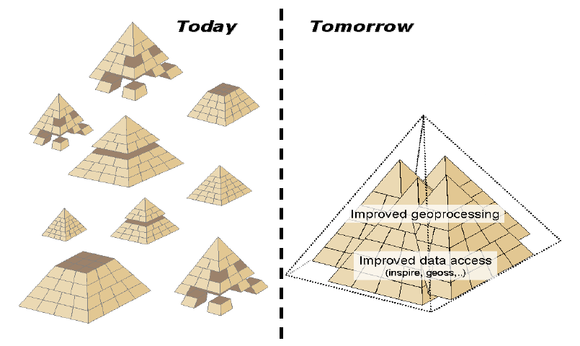
Spending more time in doing science
... and less in searching data.
Notes:
If we compare the today’s situation with pyramids, we see that we might have various parts working well but not the complete picture
for ex.:
we might have good data but no mean to make them reach the decision-makers
good data but nobody to communicate them to
partial data that reach more or less decision-makers
very rarely good data that reach the decision-makers
This could change to a quality information if:
access to and diffusion of data is improved
data analysis is improved
We could spend more time in doing science (analyzing data) and less time to look for data (in Europe we currently spend more than 50% of time to look for data in environmental reporting)

Slide 45

Tangibles
Technology
Framework
Analysis
20% technical
Tools
Methods
Systems
Intangibles
Behaviors
Resistance
Commitment
Accountability
Buy-in
Self-interests
Communication
Education
People
Process
Culture
80% relational
Notes:
- This being said, we have to remember that like the visible side of an iceberg, the technological side of the SDI is only 20% of the whole process against 80% of relational (human) part is 80% of the process
The technical side is quite easy to overcome but the human side represents most of the barriers through:
the Socio-politico-cultural context
the organizational side
People
Resources (financial and human)

Slide 46
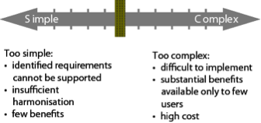
Working together
Notes:
The key element to implement a successful SDI is that people and institutions work together
Necessity to find the right balance between too easy (=> too few benefits, not enough integration) and too complicated (=> difficult to implement, too expensive)

Slide 47

Engaging stakeholders through participatory approach
Notes:
- Cooperation is an essential element influenced by political and organizational factors
In this aspect it is very important to engage efficiently all the stakeholders through a participatory approach in order to understand:
Nature of interactions
Motivations
Needs
Capacities
we must not impose as there would be resistance, but compose with them
stakeholderswill cooperate only if this addresses their own needs or mandate and if resources (human, financial) are sufficient

Slide 48

Capacity Building
Awareness raising
Notes:
Essential to re-inforce capacity building as well as raising awareness to concepts, methods and technologies linked to SDIs
The group on Earth Observation (GEO), through its GEOSS initiative (global Earth Observation System of systems)recognizes 3 levels of Capacity Building:
institutions
People
Infrastructure

Slide 49
Factors to boost or stop SDI development
Answer a need
Education
Commitment
People
“SDIs can be thought as social networks of people and organizations supported by data and technology”
“Technology is cheap, data is expensive, but social relations are invaluable”
Craglia et al. (2009)
Political - Social - Cultural context
Capacity building
Benefits
Incentives
Notes:
On a technological point of view, conclusion is that SDIs offer an interesting solution to manage, spread and analyze environmental data
but we must remember that the human component will be the main component to determine the success of an SDI
All the terms here (commitment, incentives, …read) are factors that will boost or stop the development of an SDI
Craglia says: read

Slide 50

http://www.earthobservations.org/
Voluntary partnership of governments and international organizations
Coordinated by the Group on Earth Observations (GEO)
10 Year Implementation plan (2005-2015). Fully operational by 2015.
“The Global Earth Observation System of Systems will provide decision-support tools to a wide variety of users. As with the Internet, GEOSS will be a global and flexible network of content providers allowing decision makers to access an extraordinary range of information at their desk.”
ACCESS. CONNECTING. USERS.
SYNERGIES. BENEFITS. SOLUTIONS.
Notes:
- In line with these SDI principles, some initiatives try to put them into practice
The first one is coordinated by thee Group on Earth Observation and is called GEOSS, GEOSS is a worldwide initiative that works on a VOLUNTARY and PARTICIPATIVE basis
will be fully operational in 2015
Wants to connect environmental data producers to end-users (decision-makers, scientists, …)
with goal to improve Earth Observation access to study global problems
Keywords: read

Slide 51
GEOSS Data Sharing principles
There will be full and open exchange of data, metadata, and products shared within GEOSS, recognizing relevant international instruments and national policies and legislation.
All shared data, metadata, and products will be made available with minimum time delay and at minimum cost.
All shared data, metadata, and products being free of charge or no more than cost of reproduction will be encouraged for research and education.
Notes:
GEOSS proposes some principles to stimulate data sharing:
read

Slide 52
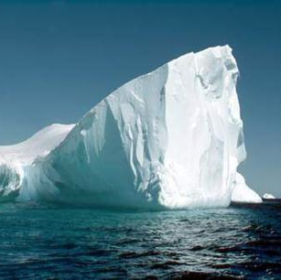
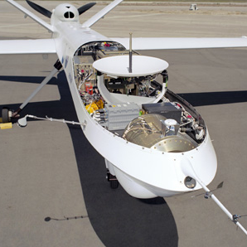
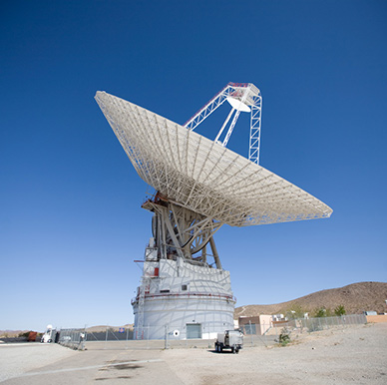

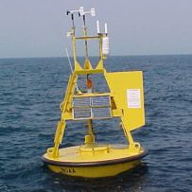
















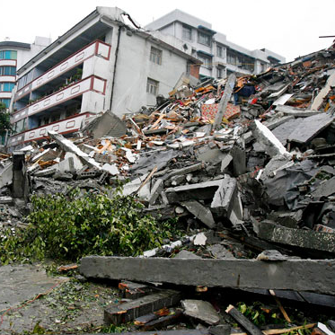
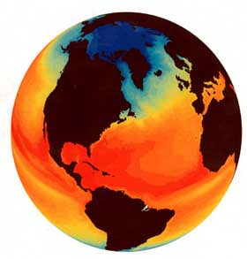


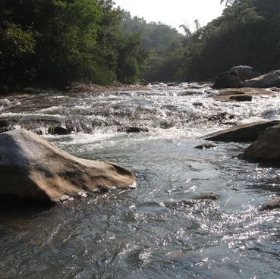

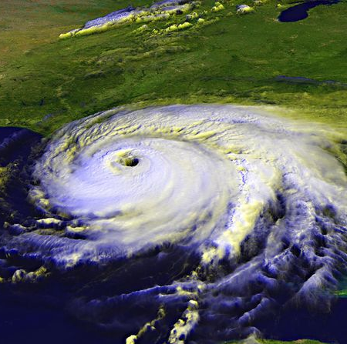
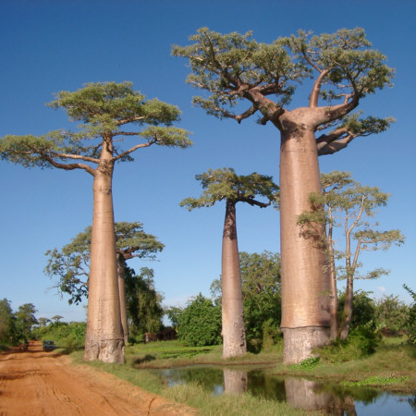

Observing Systems
Cryosphere-based
System
Air-based
System
Land-based
System
Space-based
System
Ocean-based
System
SS
Disasters
Climate
Agriculture
Biodiversity
Water
Health
Weather
Ecosystems
Energy
Societal Benefit Areas
Notes:
GEOSS, through its infrastructure, wants to connect various Earth Observation systems targeting 9 Societal Benefit Areas: read

Slide 53
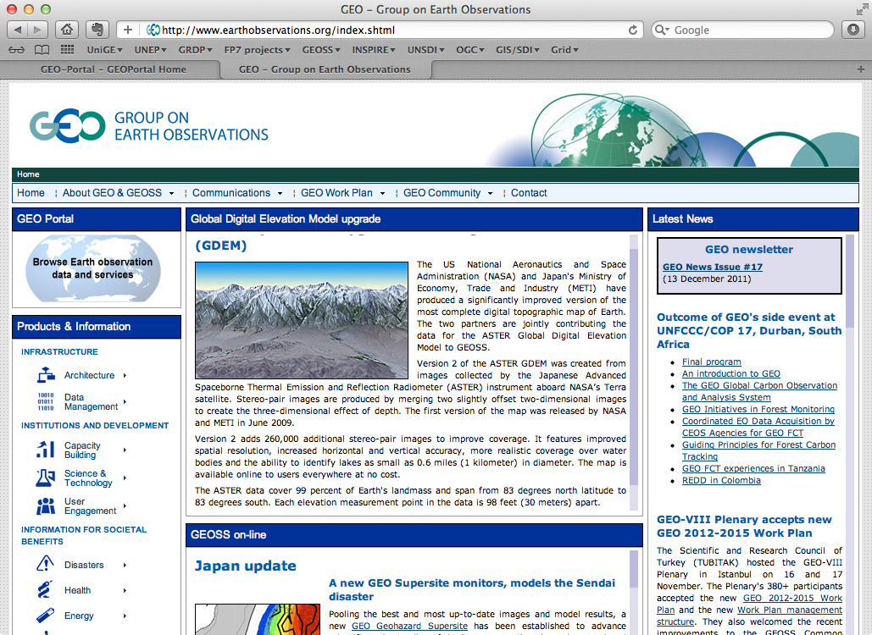
Notes:
GEOSS does not own data but is a bridge between producers and users

Slide 54
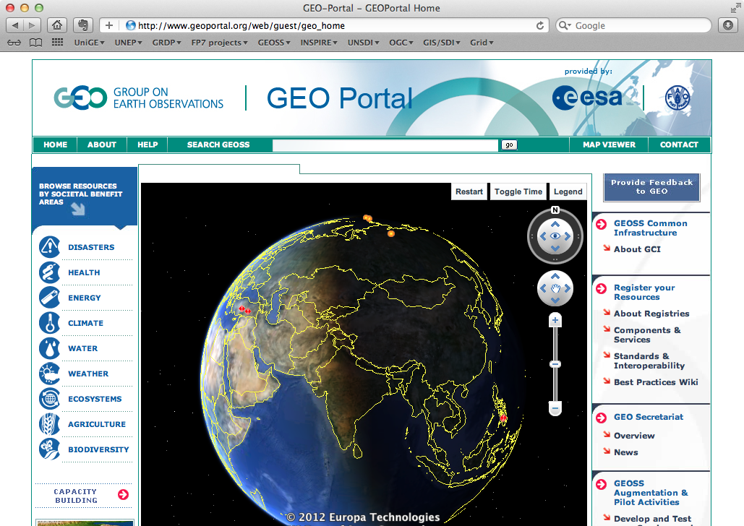
GEO Portal
Notes:
- It is the Google of scientific data

Slide 55

http://inspire.jrc.ec.europa.eu/
“The INSPIRE directive aims to create a European Union (EU) spatial data infrastructure. This will enable the sharing of environmental spatial information among public sector organisations and better facilitate public access to spatial information across Europe. A European Spatial Data Infrastructure will assist in policy-making across boundaries.”
Notes:
There is also the INSPIRE directive, EUROPEAN one, that has entered into force in May 2007
it is a binding law that coordinates member states

Slide 56
INSPIRE principles
Data should be collected only once and kept where it can be maintained most effectively.
It should be possible to combine seamless spatial information from different sources across Europe and share it with many users and applications.
It should be possible for information collected at one level/scale to be shared with all levels/scales; detailed for thorough investigations, general for strategic purposes.
Geographic information needed for good governance at all levels should be readily and transparently available.
Easy to find what geographic information is available, how it can be used to meet a particular need, and under which conditions it can be acquired and used.
Notes:
INSPIRE defines a certain number of principles to facilitate data exchange:
read

Slide 57
INSPIRE services
Discovery services: support discovery of data, evaluation and use of spatial data and services through their metadata properties
View services: as a minimum, display, navigate, zoom in/out, pan, or overlay spatial data sets and display legend information and any relevant content of metadata.
Download services: enabling copies of complete spatial data sets, or parts of such sets, to be downloaded.
Transformation services: enabling spatial data sets to be transformed (projection and harmonization).
Invoke spatial data services: enabling data services to be invoked.
Notes:
INSPIRE defines some services: read

Slide 58
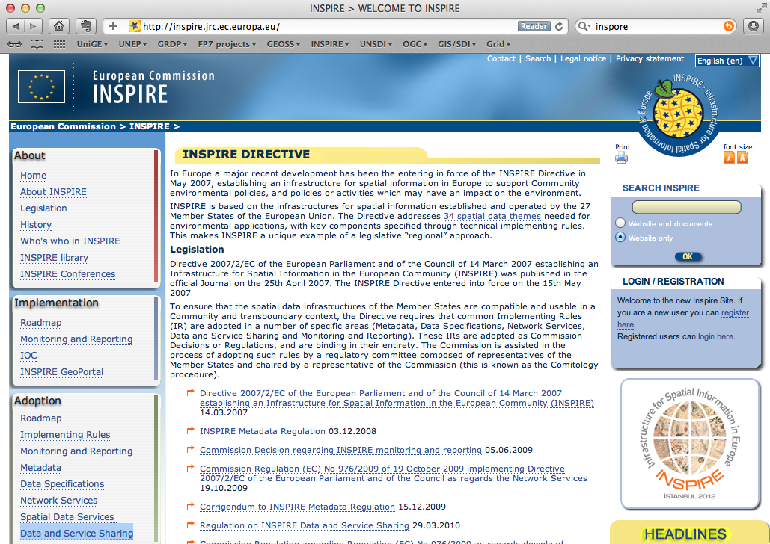
INSPIRE directive website
Notes:
It has a website

Slide 59
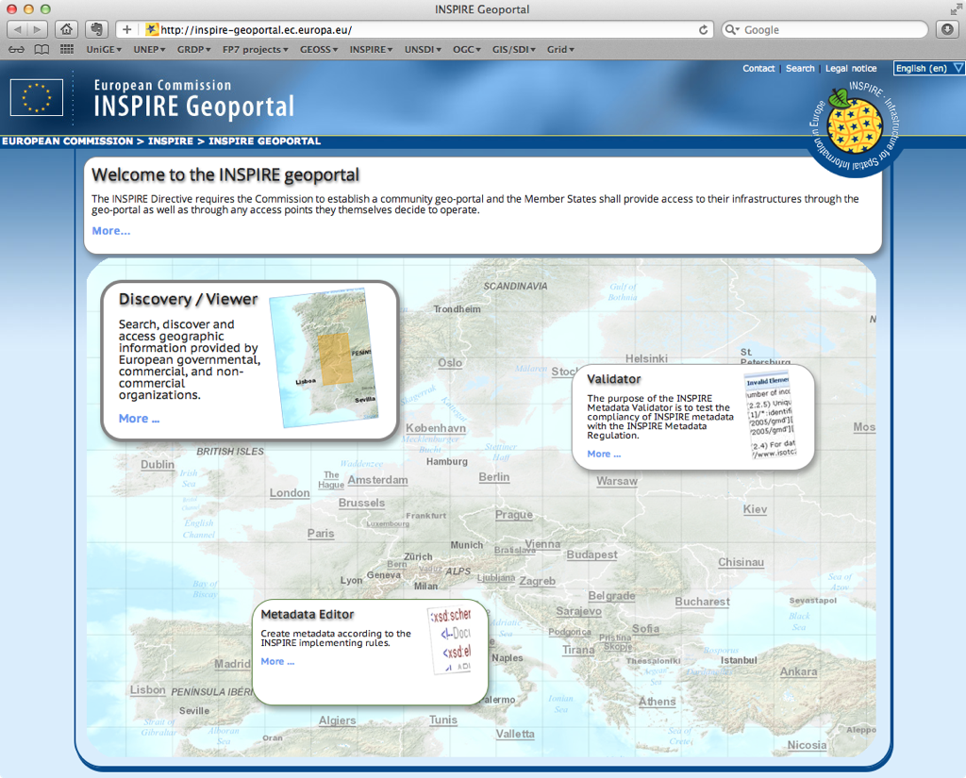
INSPIRE geoportal
Notes:
And a geoportal

Slide 60
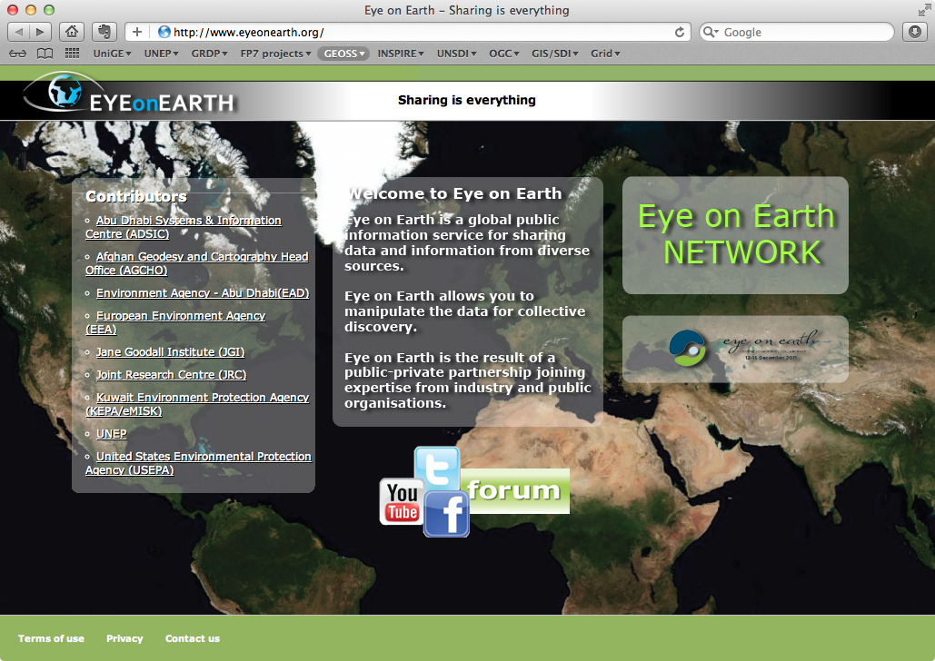
http://www.eyeonearth.org
“‘global public information network’ for creating and sharing environmentally relevant data and information online through interactive map-based visualisations”
Notes:
- Finally I will also mention the Eye on Earth initiative

Slide 61
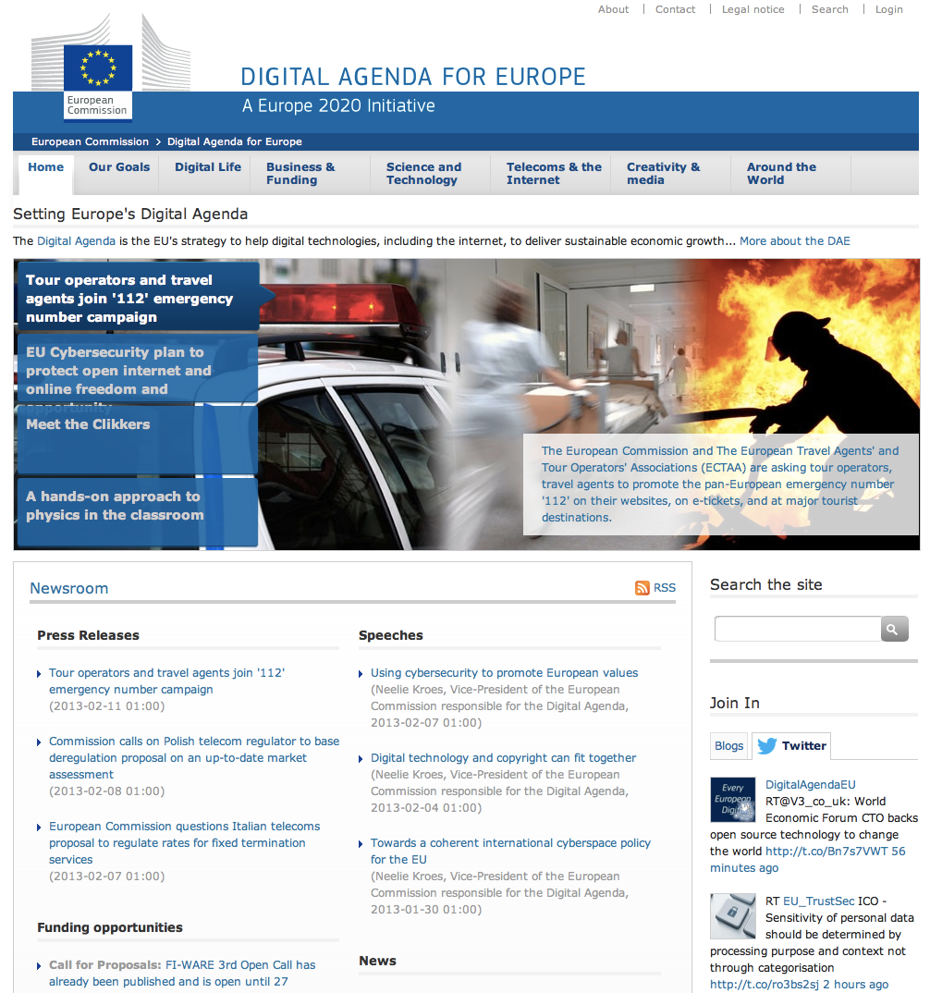
http://ec.europa.eu/digital-agenda/
“to reboot Europe’s economy and help Europe’s citizens and businesses to get the most out of digital technologies”
Notes:
And the digital agenda for Europe
=> All these are initiatives that try to make concrete the SDI concepts

Slide 62

Without sharing environmental data:
doing science can be difficult,
taking sound decisions can be problematic,
and envisioning a sustainable development can be complicated.
Notes:
We are reaching the end of this presentation but before finishing I really wish to give
you some key messages.
First:
Without sharing environmental data:
- doing science can be difficult,
- taking sound decisions can be problematic,
- and envisioning a sustainable development can be complicated.

Slide 63
Publicly funded data are a public good, produced in the public interest and thus should be freely available to the maximum extent possible.
Notes:
Publicly funded data are a public good, produced in the public interest and thus should be freely available to the maximum extent possible.

Slide 64
Sharing and documenting data is part of the elementary scientific approach.
Enhance scientific accountability and credibility.
Notes:
In a general scientific context, sharing and documenting data is part of the elementary scientific approach, allowing scientists to compare their results and methods more easily, and then enhancing scientific accountability, credibility and potentially improve quality of data for the benefit of everyone

Slide 65
Keep it simple and let users experience the benefits of interoperability
Notes:
Keep all these concepts simple, make them understandable, and let people experience by themselves the benefits of working in an interoperable context and the potential positive influence it can have on their daily business

Slide 66
Make your data discoverable
Promote GEOSS & OGC
Notes:
Make your data discoverable (do not hide them)
Promote GEOSS as a data sharing platform
and OGC Open Standards

Slide 67
SHARE, SHARE, SHARE!
Notes:
Share as much as possible spatial information that you produce!!!

Slide 68

What is Bringing GEOSS into practice ?
Train-the-trainers course developed in the framework of the FP7 enviroGRIDS project by UNIGE
Goal: promoting GEO/GEOSS data sharing principles through the use of open source & interoperable solutions
Already 450 attendees
More dates on www.geossintopractice.org

Slide 69


FP7 EOPOWER and IASON upgrade
Upgraded in common FP7 EOPOWER + IASON tasks by UNIGE, UNEP and CNR-IIA
Upgrade includes:
  new chapters (PyWPS, Discovery and Access Broker)
  latest software versions
  more step-by-step hands-on
  some sections translated in 6 languages (expected Nov. 2014)
www.iason-fp7.eu
www.eopower.eu

Slide 70

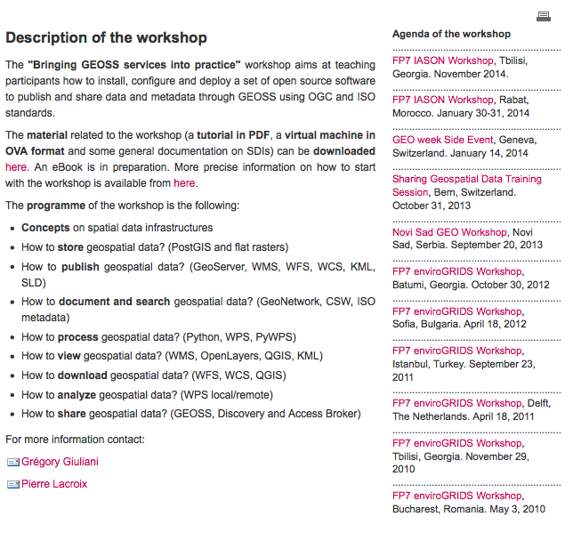

Slide 71
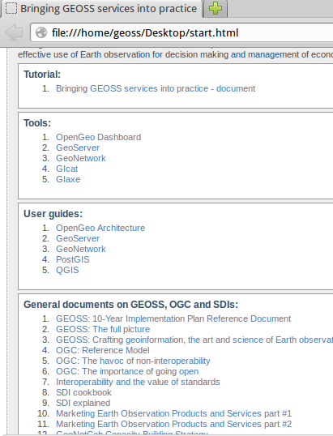

Material
PDF
eBook (iTunesStore and Google Play Books)
Virtual machine
All software / tutorial / test data already installed
Completely free (under CC license)
This work is licensed under the Creative Commons Attribution- NonCommercial-ShareAlike 3.0 Unported License. To view a copy of this license, visit: http://creativecommons.org/licenses/by-nc-sa/3.0/.

Slide 72
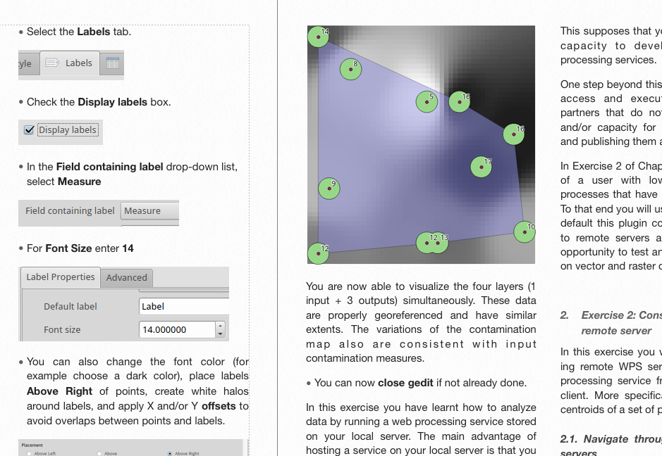
What is the approach taken?
Ask questions and answer them, e.g.
  How to store data?
  How to publish data?
Tutorial alternates theory / hands on
Simple to start with
  To complete the course users just need to copy a virtual machine on their computer
  “start” HTML page
  Possibility to go through exercises quickly (instructions: bold / bullet points)
  Simple user interface
Interoperability
  Virtual machine can be used on Mac OS, Windows, Linux
  OGC-compliant technologies
From test to production
  Deploy the VM in a production environment
Instructions are in bold + bullet points

Slide 73
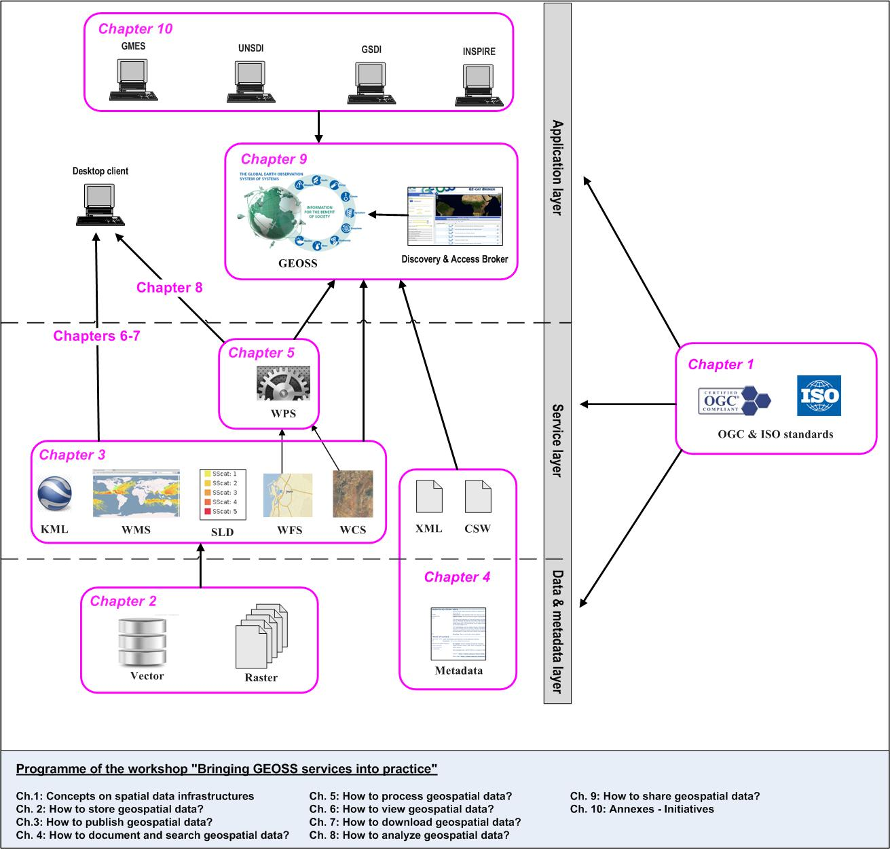




Overview

Slide 74
Chapters and related keywords
Chapter | Keywords
Summary on SDIs concepts | data sharing; Internet; interoperability; OGC; SDI; web services
How to store data? | DBMS; PostGIS; PostgreSQL; SQL
How to publish data? | GeoServer; KML; WCS, WFS; WMS; SLD
How to document and search data? | CSW; GeoNetwork; ISO19115; ISO19139; metadata; XML
How to process data? | environmental data; geoprocessing; Python script; PyWPS; Web Processing Service (WPS)
How to visualize data? | Google Earth; OpenLayers; QGIS; WMS
How to download data? | download; plugins; WCS, WFS
How to analyze data? | environmental data; geoprocessing; local server; PyWPS; remote server; Web Processing Service (WPS)
How to share services with others? | GEO discovery and Access broker; GEOSS registration

Slide 75
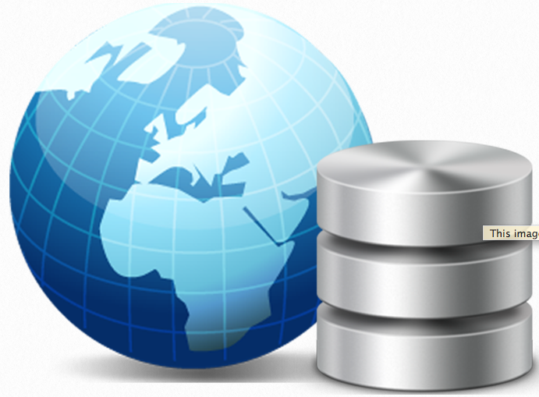
How to store data?
Keywords:
DBMS
PostGIS
PostgreSQL
SQL

Slide 76
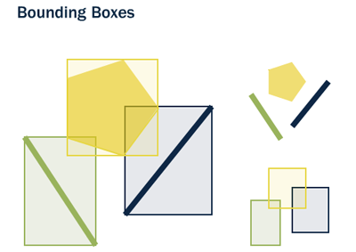
How to store data?
What is a spatial database?
To store geospatial data, spatial databases are the best mean
Spatial databases store and manipulate spatial objects like any other object in the database.
Examples: PostGIS, Oracle Spatial, SQL server 2008, …
An ordinary database has strings, numbers, and dates. A spatial database adds additional (spatial) types for representing geographic features.
Spatial databases provide a “spatial index” that answers the question “which objects are within this particular bounding box?”.

Slide 77
How to store data?
PostgreSQL/PostGIS
PostgreSQL is a powerful object-relational database management system, free and open source software
PostGIS turns the PostgreSQL Database Management System into a spatial database by adding adding support for the three features: spatial types, indexes, and functions

Slide 78
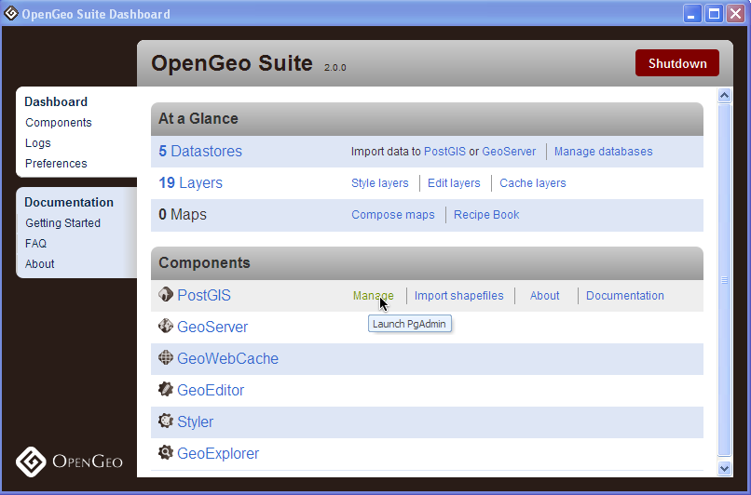
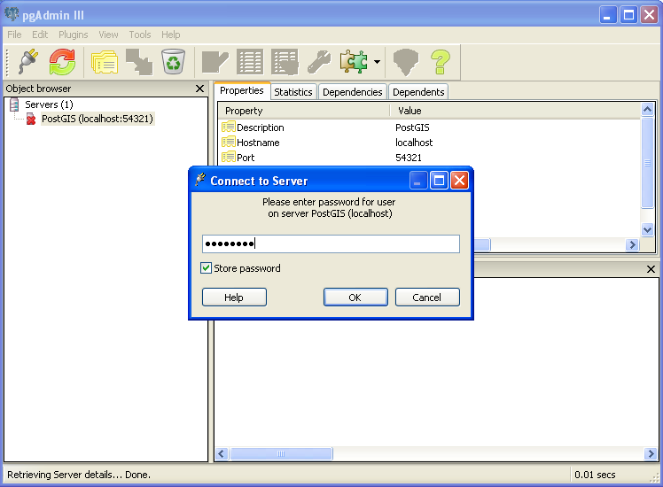
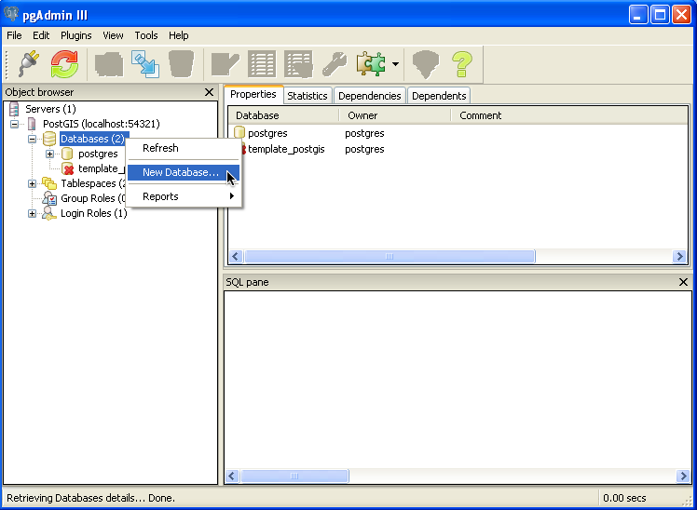
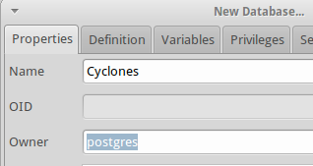
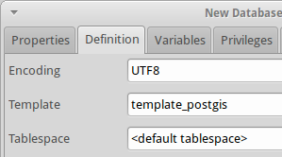

How to store data?
Creating a spatial database (in PostGIS)
1) Launch pgAdmin III (PostgreSQL administration interface)
from OpenGEO dashboard
2) Double-click PostGIS (localhost:5342) and use “opengeo”
as password
3) Create the database:
a) Right-click on the Databases item and select New Database
b) Fill the form:
  Name: Cyclones
  Owner: Postgres
  Template: template_postgis
  c) Click OK
  The database is created! You can check it by running the following SQL query : SELECT postgis_full_version();

Slide 79




How to store data?
Loading spatial data (shapefile) in PostGIS
1) Launch pgShapeLoader
2) Click Add File and select a shapefile to upload (ex: cy_buffers.shp)
3) Set the connexion details:
  Username: opengeo
  Password: opengeo
  Serverhost: localhost
  Port: 5432
  Database: Cyclones
  4) Click OK and Import
  The shapefile is now imported in the The PostGIS database! A new table “cy_buffers” should now exist when opening the “Cyclones” database in pgadmin

Slide 80

How to publish data?
Keywords:
Geoserver
KML
WCS
WFS
WMS
SLD

Slide 81

How to publish data?
Geoserver basics
GeoServer is an open source software server written in Java that allows users to
share and edit geospatial data
a web mapping server uses protocols that are designed specifically for the
transfer of geographic information
the protocols used can be proprietary or open (ex: WMS, WFS)
examples of web mapping servers: geoserver, mapserver, mapnik, ArcGIS server, …
Geoserver can read from different data sources:
  files: Shapefile, GeoTIFF, ArcGrid, JPEG2000, GDAL formats
  databases: PostGIS, ArcSDE, Oracle Spatial, DB2, SQL Server
  GeoServer implements standard open web protocols established by the Open
  Geospatial Consortium (OGC) : WMS, WFS, WCS

Slide 82

How to publish data?
Geoserver basics: WMS
  Web Map Service (WMS):
  standard protocol for serving georeferenced map images generated by a map server
  Example of WMS request:
  http://suite.opengeo.org/geoserver/wms?
  SERVICE=WMS&
  VERSION=1.3.0&
  REQUEST=GetMap&
  LAYERS=usa:states&
  SRS=EPSG:4326&
  BBOX=24.956,-124.731,49.372,-66.97&
  FORMAT=image/png&
  WIDTH=600&
  HEIGHT=255

Slide 83

How to publish data?
Geoserver basics: WFS
  Web Feature Service (WFS):
  standard protocol for serving actual geographic data that comprise the map images
  Example of WFS request:
  http://suite.opengeo.org/geoserver/wfs?
  SERVICE=wfs&
  VERSION=1.1.0&
  REQUEST=GetFeature&
  TYPENAME=usa:states&
  FEATUREID=states.39
  Feature=single unit of geographic data, such as a polygon or point
  request returned as an .xml file, easy to parse for computers

Slide 84
How to publish data?
Geoserver basics: WCS
  Web Coverage Service (WCS):
  standard protocol that enables access to the underlying raster (or “coverage”) data
  Equivalent of WFS but for raster data

Slide 85
How to publish data?
Geoserver basics: WPS
  Web Processing Service (WPS):
  Service for the publishing of geospatial processes, algorithms, and calculations
  allows to create processes based on data served in GeoServer, including the
  results of a process to be stored as a new layer

Slide 86
How to publish data?
Geoserver concepts
  Workspace:
    name for a notional container to group similar data together
    makes it possible to use layers with identical names without conflicts
    ex: nyc:streets
  Store:
    name for a container of geographic data, that refers to a specific data source. The
    data source can be: a shapefile, a database, or any other data source that GeoServer
    supports
    it can contain many layers, as in the case of a database that contains many tables.
    A store can also have a single layer, such as in the case of a shapefile or GeoTIFF,
    which can only contain one layer
    GeoServer saves the connection parameters to each store
    Each store must also be associated with one (and only one) workspace

Slide 87
How to publish data?
Geoserver concepts (continued)
  Layer:
  collection of geospatial features or a coverage
  contains one type of data (points, lines, polygons, raster)
  GeoServer stores information associated with a layer, such as projection information,
  bounding box, associated styles, and more
  Layer group:
    collection of layers
    makes it possible to request multiple layers with a single WMS request
    relevant only to WMS requests
    Style:
      GeoServer recognizes styles in Styled Layer Descriptor (SLD) format
      visualization directive for rendering geographic data (color, shape, size, …)
      every layer must be associated with at least one style.

Slide 88





How to publish data?
Geoserver concepts: web administration
  web-based administration interface available by default at
  http://localhost:8080/geoserver
  authentification needed (by default admin:geoserver)
  the Layer Preview link allows to easily view layers
  currently being served by GeoServer.
➔
➔
➔

Slide 89



How to publish data?
Geoserver: Creating a workspace
  from the dashboard (http://localhost:8080/geoserver), click on “Workspaces”
  Click on “Add new workspace”
  Fill the name of the new workspace (ex: geoss), its URI (ex: http://localhost/geoss) and submit
Your workspace is created!

Slide 90




How to publish data?
Geoserver: Publishing a PostGIS layer
  from the dashboard (http://localhost:8080/geoserver), click on “Stores”
  Click on “Add new store” and choose “PostGIS” as type of store
  Choose PostGIS
  Fill the form with data source name (ex: cy_buffers) and description, as well as the database connexion parameters
  At this stage, the store is created but the layer not published yet
  5) Click Publish

Slide 91




How to publish data?
Geoserver: Publishing a PostGIS layer (continued)
  6) Fill the “Data” tab, in particular: name, declared SRS, Bounding boxes
  When you submit, your layer is published in Geoserver!
  You can see it by clicking on the “Layer Preview” link
  We’ll see later how to change the style
  Publishing shapefiles, rasters or other formats
  follows the same procedure
⬇
⬇

Slide 92


How to publish data?
Geoserver: styling
  GeoServer uses the Styled Layer Descriptor (SLD) markup language to describe geospatial data
  Every published layer must have an associated style
  Typical structure of a .sld file:
    Header: contains metadata about XML namespaces
    FeatureTypeStyle: group of styling rules
    Rules: single styling directive
    Symbolizers: actual style instruction. 5 types:
      PointSymbolizer
      LineSymbolizer
      PolygonSymbolizer
      RasterSymbolizer
      TextSymbolizer
➔

Slide 93




How to publish data?
Geoserver: styling (continued)
  To modify a style:
  Select the “Styles” line
  Click on the style name to edit (ex: polygon), which will open the style editor
  For example, find the line that starts with <CssParameter name="fill"> and change the RGB code to #0000ff (blue).
  3) Make the necessary changes, validate and submit
⬇

Slide 94





How to publish data?
Geoserver: styling (continued)
  To associate a style with a layer:
  select the layer in question (ex: geoss:cy_buffers)
  Click on the “publishing” tab and go to “default style”
  Scroll down to the Default style drop down list and choose the one you want (ex: cy_buffers_yellow_red)
  Save
  Your layer will look differently!
⬇
⬇
⬇
⬇

Slide 95


How to publish data?
Geoexplorer
  It is a vizualisation tool available from the dashboard
  Layers can be added by clicking on the green button
  Geoexplorer also allows to modify the style of a layer (needs to be logged in) but
  !!! it makes changes directly to an SLD, and will completely recreate the SLD file !!!
➔
This changes both the .sld code and the visual rendering

Slide 96




How to publish data?
Google Earth
  Google Earth is a powerful 3D map viewer.
  Any layer served by GeoServer can be loaded into Google Earth
  There are two ways to view data in Google Earth:
    by statically loading a KML file
    by using a Network Link and connecting to a KML stream
  Loading a .kml file:
  1.1) click on “layers preview”
  1.2) select “Google Earth” in the dropdown list next to the layer you want to display (ex: geoss:lmz_po_shp) and click “Go”
  1.3) Accept to open the .kmz with Google Earth
  1.4) Click on one of the layer’s points to view its placemark description
➔
➔
➔

Slide 97


How to publish data?
Google Earth (continued)
  2) using a Network Link and connecting to a KML stream:
  2.1) Add a new Network Link by navigating to the “Add menu and selecting Network Link”
  2.2) Fill the form as follows:
  Name: Large Marine Areas
  Link: http://localhost:8080/geoserver/wms/kml?layers=geoss:lmz_po_shp
  2.3) click OK
➔
2.4) possible to add a filter to only show certain features: add &cql_filter=LME_NAME=‘Faroe Plateau’ at the end of the link =>
Advantage of network link: if a modification is made on the source, directly reflected on the .kmz!

Slide 98

How to document and search data?
Keywords:
CSW
Geonetwork
ISO19115
ISO19139
Metadata
XML

Slide 99


How to document and search data?
What is a metadata?
Metadata is a data….
which describe another data
It provides information about a certain item's content. For example, an image may include metadata that describes how large the picture is, the color depth, the image resolution, when the image was created, and other data.
Geospatial metadata (geographic metadata) is a type of metadata that is applicable to objects that have an explicit or implicit geographic extent

Slide 100

How to document and search data?
Importance of metadata
Metadata is a vital tool for management of spatial data and plays a key role in any spatial data infrastructure (SDI) initiative

Slide 101
How to document and search data?
Why metadata?
  1) Access
  2) Interoperability
  3) Management
  4) Rights
  5) Preservation

Slide 102

How to document and search data?
Why metadata? 1) Access
Source: The story of data on the environment http://www.youtube.com/watch?v=9SKOwQDFhYI&feature=related

Slide 103

How to document and search data?
Why metadata? 2) Interoperability
“the ability of two or more systems or components to exchange information and to use the information that has been exchanged”
Catalog Services for the Web (CS-W)
Defines several web interfaces for data discovery
Metadata
Notes:
What is interoperability?
it is the capacity to facilitate integration, just like 2 pieces of a puzzle
- Read definition

Slide 104


How to document and search data?
Why metadata? 3) Management of the storage of data

Slide 105
How to document and search data?
Why metadata? 4) Rights
Manages and protects the rights
Because the use of a metadata catalog does not give directly access to the spatial data, it is easy to list the various ways to obtain them.
Moreover, if the rights of use are applicable, they may also be indicated in the metadata.
Legal
Digital rights
Ownership
Responsability
Copyright
Notes:
- An interoperable system has several facets:
- Of course technical
- semantic (même terminologie)
- legal
- and human: this is the reason why we are here today: to train, to exchange, to collaborate, …

Slide 106


How to document and search data?
Why metadata? 5. Preservation
Trash!!
We don’t know anything about this image

Slide 107


How to document and search data?
Geonetwork: creation of metadata online
From :C. Plumejeaud , et al (2011): Opérationnalisation d’un profil ISO 19115 pour des métadonnées socio-économiques
The ISO 19115 Standard defines an extensive set of metadata elements; (typically only a subset of the full number of elements is used).

Slide 108

How to document and search data?
Geonetwork: creation of metadata online
The ISO19115-19139 standards seem to confuse many people. There is only one (1!) metadata standard for geographic data, and that is the ISO-19115 metadata standard.
The ISO-19115 standard was originally released without a DTD or XML schema that could be used to validate such a metadata record (formatted as an XML document).
It was decided by ISO TC211 to develop a specific implementation standard, called ISO-19139. This standard would have the form of a metadata scheme (an XSD document). The schema can be used to validate the structure of an ISO-19115 document

Slide 109

How to document and search data?
Metadata and standards
Notes:
standards make it possible to consider data as a shared resources, that can be useful in several domains and for various communities

Slide 110






How to document and search data?
Examples of projects using GeoNetwork

Slide 111



How to document and search data?
What is Geonetwork?
GeoNetwork opensource is a standard based and decentralized spatial information management system, designed to enable access to geo-referenced databases and cartographic products from a variety of data providers through descriptive metadata,
enhancing the spatial information exchange and sharing between organizations and their audience, using the capacities and the power of the Internet.
Notes:
- Cooperation is an essential element influenced by political and organizational factors
In this aspect it is very important to engage efficiently all the stakeholders through a participatory approach in order to understand:
Nature of interactions
Motivations
Needs
Capacities
we must not impose as there would be resistance, but compose with them
stakeholderswill cooperate only if this addresses their own needs or mandate and if resources (human, financial) are sufficient

Slide 112

How to document and search data?
Main features
Instant search on local and distributed geospatial catalogues
Uploading and downloading of data, documents, PDF’s and any other content
An interactive Web map viewer that combines Web Map Services from distributed servers around the world
Online map layout generation and export in PDF format
Online editing of metadata with a powerful template system
Scheduled harvesting and synchronization of metadata between distributed catalogues
Groups and users management
Fine grained access control

Slide 113

How to document and search data?
Geonetwork: basics
Accessible through a web browser (ex: http://localhost:8080/geonetwork)
Login necessary (admin:admin) to access the “Administration” functionalities
➔
To enter metadata, possible to:
  enter it in the online form
  import a .xml file following a standard (ex: ISO19139)

Slide 114



How to document and search data?
Geonetwork: creation of metadata online
In the “Administration” part of GeoNetwork, click on the New Metadata link
Select a template (for ex. “Template for Vector data in ISO19139 (preferred!)”) and the group “Sample group” and click on “Create”
3) Document the various fields
4) Save and close
Your metadata record is then saved and it can be searched from the homepage on the internet

Slide 115


How to document and search data?
Geonetwork: import of a .xml file
In the “Administration” part of GeoNetwork, click on the Metadata insert
Select the .xml file to import (it must follow a standard!) click on “Insert”
3) You should see then a message informing that the metadata has been added
4) Click on the Edit button to make sure all the fields have been filled properly
Your metadata record is then saved and it can be searched from the homepage on the internet
⬇

Slide 116



How to document and search data?
Geonetwork: harvesting
GeoNetwork offers the possibility to automatically populate its metadata records from other online metadata sources => harvesting
Harvesting: “the process of collecting metadata from a remote source and storing it locally in GeoNetwork for fast searching via Lucene”.
Procedure:
1) In the “Administration” part of GeoNetwork, click on the Harvesting management
2) Click on Add and choose the appropriate type of harvesting (ex: Geonetwork v2.1 remote node)
3) Fill the various criteria and save. Ex:
  Name: PEGASO - Country limits Level 0
  URL: http://pegasosdi.uab.es:80/catalog
  Free text: Global Administrative Areas - LEVEL 0
  4) Run this harvest
On the homepage, you should see new metadata records
corresponding to this harvesting

Slide 117


How to document and search data?
Geonetwork: harvesting (continued)
It possible to harvest through other harvesting types
For ex. Catalogue Services for the Web ISO Profile 2.0 offers the possibility to perform CSW queries with more filtering possibilities
➔
http://geonetwork.grid.unep.ch:8080/ge onetwork/srv/en/csw?request=GetCap abilities&service=CSW&acceptVersions =2.0.2

Slide 118


How to document and search data?
Geonetwork: users privileges
The metadata records can be public or restricted to certain groups
To visualize and manage the users privileges and categories, necessary to be logged in as admin
Procedure:
  Go to the metadata record to parameter
  Click Other actions > Privileges
  Assign privileges for the various groups in question and submit
⬇

Slide 119

How to document and search data?
Geonetwork: categories
GeoNetwork gives the possibility to either assign existing categories to metadata records or to create new categories (ex: INSPIRE categories)
You can do so in the Administration part, Category Management > Add a new Category
Through Other actions > Categories, you can then assign a category to the record in question

Slide 120




How to document and search data?
Geonetwork: searching metadata
The default search allows you to search text within the entire record, such as keywords of the metadata and/or geographic location
the geographic search allows to select a particular region to limit the search
  from a predefined list
  from a selected area
  You can also perform a search by categories
  or an advanced search (what? when? where? category? …)

Slide 121


How to document and search data?
Geonetwork: viewing metadata
The output of a search provides you a list of the metadata records that should fit your request. For each record, the result page shows the title, an abstract and the keywords
When expanded, there is the whole metadata description and possibly the download button depending on the privileges

Slide 122

How to process data?
Keywords:
Environmental data
Geoprocessing
Python script
PyWPS
Web Processing Service (WPS)

Slide 123
How to process data?
web processing services: basics
OpenGIS® Web Processing Service (WPS) Interface Standard:
rules for standardizing inputs and outputs (requests and responses) for
geospatial processing services (ex: polygon overlay)
Python: open source and free programming language that includes dozens of functions for managing and analyzing geospatial data
Python Web Processing Service (PyWPS): implementation of the Web Processing Service standard from Open GeoSpatial Consortium. It has been written with native support for GRASS GIS.
Quantum GIS (QGIS): cross-platform free and open source desktop application that provides data viewing, editing and analysis capabilities. It supports a number of plugins, in particular a WPS client for consuming web processing services

Slide 124



How to process data?
web processing services: exercice
we will use a .gml file (GML is an eXtensible Markup Language (XML) grammar for expressing geographical features). We will first check it in QGIS.
Procedure:
  Click on “Add vector layer” , select the “Measures.gml” file and choose a EPSG:4326 coordinate system (corresponds to WGS 84)
  The attribute table contains 4 fields: X, Y coordinates, value and ID.
  Close QGIS
⬇

Slide 125




How to process data?
web processing services: exercice
we will then use a text editor (ex: gedit) to write a python script that we will call processing.py.
The script will be composed of three main parts: (1) initialization of the process and declaration of useful libraries, (2) declaration of the input and output parameters, and (3) coding of the geoprocessing operations through specific commands.
Part 1
Part 2
Part 3

Slide 126
How to process data?
web processing services: exercice
You will then need to publish the script on your local server
Publishing a PyWPS process requires storing specific information in the processes directory, for example /usr/local/lib/python2.7/dist-packages/pywps-3.2.1-py2.7egg/pywps/processes
It will contain:
  An __init__.py file which sets the __all__ array to contain the list of available variables
  All Python scripts that you want to publish as web processing services, for example processing.py
  to publish it on your local server, you can do it using a terminal emulator and giving the read, write and execute privileges on your Python script (CHMOD 777)
  With this the WPS is published on your local server and ready to be consumed (executed) by a client (ex: QGIS WPS plugin). This will be done later in the chapter "how to analyze data"

Slide 127

How to visualize data?
Keywords:
Google Earth
Open Layers
QGIS
WMS

Slide 128
How to visualize data?
web mapping services: basics
The Web Map Service defines an interface that allows a client to retrieve maps of georeferenced data
In WMS context, a map means a graphical representation (jpeg ,gif or png files) of a geospatial data meaning that a WMS service does not give access to the data itself
A traditional WMS interface, invoked by a URL, consists of the following operations:
  GetCapabilites: answer to a client telling him what kind of layers are available and which ones are queryable
  GetMap: produce a map as a picture showing selected layers
  GetFeatureInfo: answer simple queries about the content of the map

Slide 129

How to visualize data?
web mapping services: basics (continued)
The Web Map Service defines an interface that allows a client to retrieve maps of georeferenced data
Example of a WMS URL with a GetCapabilities request that returns to the user an XML document describing the service and the data sets available:
  http://preview.grid.unep.ch:8080/geoserver/wms?request=GetCapabilities

Slide 130

How to visualize data?
web mapping services: basics (continued)
The GetMap operation is the most important of the three basic operations of the WMS interface as it returns to a client request a map of selected geospatial layers
Example of a WMS URL with a GetMap request :
  http://preview.grid.unep.ch:8080/geoserver/wms?bbox=-178.21655,18.92548,-66,71.35144&
  styles=&
  Format=image/png&
  request=GetMap&
  version=1.1.1&
  layers=preview:cy_buffers,preview:Admin1&
  width=640&
  height=309&
  srs=EPSG:4326

Slide 131

How to visualize data?
web mapping services: basics (continued)
The GetFeatureInfo operation is used to query the attribute table of a selected layer and get information on a specific feature
Example of a WMS URL with a GetFeatureInfo request :
  http://ogi.state.ok.us/geoserver/wms?SERVICE=WMS&VERSION=1.1.1&
  REQUEST=GetFeatureInfo&
  SRS=EPSG:4326&
  BBOX=-104.5005,32.7501,-94.01,37.20&
  WIDTH=800&
  HEIGHT=300&
  LAYERS=ogi:okcounties&
  QUERY_LAYERS=ogi:okcounties&
  STYLES=&
  X=550&
  Y=105

Slide 132
How to visualize data?
web mapping services: OpenLayers
OpenLayers is an open JavaScript library for displaying map data in web browsers.
It consists in a javascript file (OpenLayers.js) and a folder (img) to be put on the server
It is then necessary to write an .html file that will call this library and contain all the necessary code to add desired geographic layers

Slide 133



How to visualize data?
web mapping services: OpenLayers
The html file (that can be edit in a text editor, e.g. gedit) must contain a few important elements:
  the structure of the html page that will render the map
  a script tag which includes the OpenLayers library to the page
  the map viewer (element in which the map will be placed)
  layers (WMS): example of a background map from metacarta
html structure
Script tag for OpenLayers library
Layers (WMS)
Map viewer

Slide 134


How to visualize data?
web mapping services: OpenLayers
You can also add other features on a map:
  additional layers (either base maps or other thematic maps)
  controls: overview map, scale line, layer switcher, mouse position, pan panel, …
  When opening the corresponding .html file in a web browser, it renders the map!
➔

Slide 135





How to visualize data?
web mapping services: vizualisation
WMS layers can be visualized in several ways
  in OpenLayers (as just demonstrated)
  in Google Earth (as seen earlier in the presentation)
  in a client GIS software (ESRI ArcGIS, Quantum GIS, …)
  Display of WMS layers in QGIS:
    Click on “add WMS layer”
    Click “New” and give a name to this connection (ex: Preview – WMS).
    Insert a WMS url (ex: http://preview.grid.unep.ch:8080/geoserver/wms?)
    Click “OK” and “Connect”, then click on “title” to sort the layers by title
    Click the identify features button to query data of your layer
⬇
⬇
⬇
⬇

Slide 136

How to download data?
Keywords:
Download
Plugins
WFS
WCS

Slide 137





How to download data?
Downloading and editing data in a desktop GIS client
We use QGIS as a GIS client in this demo
  We will add Web Feature Services in QGIS:
    Click on “add WFS layer”
    Click “New” and give a name to this connection (ex: Preview – WFS).
    Insert a WFS url (ex: http://localhost:8080/geoserver/wfs)
    Click “OK” and “Connect”, then click on “title” to sort the layers by title
    Select lmz_po_shp layer, that was published earlier in GeoServer and “Apply”, “close”
    The attribute information is available either through the identify features button
    or through the attribute table
    If desired, you can save the data as a shapefile
⬇
⬇
⬇

Slide 138



How to download data?
Downloading and editing data in a desktop GIS client
If the transactional feature of a WFS service is enabled, users can edit online the data using the Edit toolbar
You can for example move a point (the one in red), which will make a modification in the attribute table
if you save the edits, this modification will remain online!
⬇
⬇

Slide 139

How to analyze data?
Keywords:
Environmental data
Geoprocessing
Local server
PyWPS
Remote server
Web Processing Service (WPS)

Slide 140





How to analyze data?
Consuming a WPS hosted on a local server
a python script had been written in the part “how to process data?” . We will now use it in QGIS WPS client through a graphical user window
Procedure:
  Open processing.py in a text editor (ex: gedit)
  This file contains input and output parameters:
  Input layer that contains geospatial objects
  Declaration of the buffer distance
  Output GML file with buffers, encoded as xml
  Interpolation surface that will be created by the process (tiff image)
  The process will also produce a shapefile named outputHull in the /tmp directory

Slide 141











How to analyze data?
Consuming a WPS hosted on a local server (continued)
in QGIS, add the “Measures.gml” file as a vector layer (EPSG:4326)
connect to your local WPS server through the QGIS WPS client (name: My WPS; url: http://localhost/cgi-bin/pywps.cgi?service=WPS&request=getcapabilities)
At this stage, you should see all the existing processes existing on your server. Choose the “Processing” row and click OK.
In the opening window, you should see 4 parameters:
  drop-down list with an identifier (data) and a title (Input data)
  => select measures
  a blank field that allows you to enter a value for the buffer distance
  => enter 0.1 value in DD corresponding to 10 km)
  output buffer stored in a GML file and encoded in XML
  output interpolation surface stored in TIFF format
➔
➔
➔
➔
➔

Slide 142



How to analyze data?
Consuming a WPS hosted on a local server (continued)
Click “Run” to run the web processing service
Select “EPSG:4326” (WGS 84) and click OK. A new raster layer is added to the QGIS project
The processing has also created other layers. Add them with the “Add vector layer” tool and with EPSG:4326
Make adjustments so that it displays better (layers order, transparency, raster coloring, labels, …
➔
➔

Slide 143





How to analyze data?
Consuming a WPS hosted on a remote server
in QGIS, click on “connect” of the WPS plugin and click on “Add default server”
Select “52 North” from the drop-down list, click “Connect”
Do the same for “Kappasys WPS server”, “ZOO project grass” and “geodati.fmach.it”
Add the vector layer “Parcels.gml”, select the “geodati.fmach.it” server and click “connect”.
Select the “CentroidPy” function to generate the centroids of the parcels that have been added to the QGIS map
Click “OK” and “Run”. When the process is finished, the Coordinate System Reference Selector window shows up. Select “EPSG:4326” (WGS 84) and click “OK” twice.
➔
➔
➔
A new layer is added to the map. A centroid has been created for each parcel. The centroids layer is in WGS 84 as is the case of the parcels layer.

Slide 144
How to share services?
Keywords:
Global Earth Observation System of Systems (GEOSS)
Discovery Broker
Access Broker
WMS – WFS – WCS – CSW

Slide 145
GEO Discovery and Access Broker
Outline
Introduction to brokering
The GEOSS Common Infrastructure
GEO DAB functionalities
Notes:
Good morning
My name is Yaniss Guigoz from university of Geneva and GRID-Geneva
lire titre

Slide 146

SDI services
OGC
INSPIRE Network Services
(Publishing)
Portrayal
Discovery
Access
Processing
(Composition/workflow)
View
Discovery
Download
Transformation
Invoke Spatial Data Services
Notes:
High constraint on distribution: current SDI designs call for SOA.
The types of fundamental SDI services are still under investigation
e.g., arguably, Portrayal is a kind of processing, but the distinction is sound due to the importance of visualizing data.

Slide 147




















































Forestry e-Infrastructure
Best practices
Data policies
Security (AAA)
Service Consumer
Service Consumer
Forestry Service Bus
Service Provider
Service Provider
Service Provider
Metadata model(s)
Data Model(s)
Encoding Format(s)/Language(s)
Controlled Vocabulary(ies)
Data conventions
Semantics
Discovery protocol(s)/interface(s)
Access protocol(s)/interface(s)
Visualization protocol(s)/interface(s)
Processing protocol(s)/interface(s)
Notes:
A thematic cyberinfrastructure consists of a set of common standards and rules (e.g. best practices) adopted by both Data Producers and Users to publish, find and bind to the available resources.
Registry services and a generic portal are commonly implemented at the infrastructure level.
Architectures implementing this pattern are known as Federated Architectures.
In fact, they are based on the concept of "common/federal data model" and "common federal interoperability protocol(s)”.
Most SDIs around the world are based on this model (see for example the National Spatial Data Infrastructure in the USA, and INSPIRE in Europe. Examples in the geosciences are GEON, CUAHSI and OneGeology).
When we want to bridge several of them, e.g. in a multi-disciplinary cyberinfrastructure, the picture gets complicated…

Slide 148
Forestry e-Infrastructure
Best practices
Data policy
….
Service Consumer
Service Consumer
Forestry Service Bus
Service Provider
Service Provider
Service Provider
Metadata model(s)
Data Model(s)
Encoding Format(s)/Language(s)
Controlled Vocabulary(ies)
….
Discovery protocol(s)/interface(s)
Access protocol(s)/interface(s)
Visualization protocol(s)/interface(s)
Semantic protocol(s)/interface(s)
…

Slide 149



Forestry e-Infrastructure
Meteo-Ocean e-Infrastructure
Service Consumer
Service Consumer
Service Consumer
Service Consumer
Discipline D Service Bus
Service Provider
Service Provider
Service Provider
Forestry Service Bus
Drought e-Infrastructure
Service Provider
Service Provider
Service Provider
Service Consumer
Service Consumer
Drought Service Bus
Service Consumer
Service Consumer
Service Provider
Service Provider
Service Provider
Biodiversity Service Bus
Biodiversity e-Infrastructure
Service Provider
Service Provider
Service Provider
Notes:
Keeping the cyberinfrastructure level as simple as possible entails that the complexity lies almost entirely on Data Producers and Users .
Such Data Producers and User entry barriers reduce their willingness in investing resources to participate in cross-disciplinary or multi-disciplinary infrastructures.
On the contrary, they are focused on developing disciplinary and thematic capacities that increase the need for cross-organizational, multi-disciplinary infrastructures.

Slide 150
Forestry e-Infrastructure
Meteo-Ocean e-Infrastructure
Service Consumer
Service Consumer
Service Consumer
Service Consumer
Discipline D Service Bus
Service Provider
Service Provider
Service Provider
Forestry Service Bus
Drought e-Infrastructure
Service Provider
Service Provider
Service Provider
Service Consumer
Service Consumer
Drought Service Bus
Service Provider
Service Provider
Service Provider
Service Consumer
Service Consumer
Biodiversity Service Bus
Service Provider
Service Provider
Service Provider
Biodiversity e-Infrastructure

Slide 151












The data access issue
Heterogeneity of the discovered data
  Different access service
  Different format
  Different CRS
  Different resolution
  Different geo-extent
    space & time
WCS
WFS
WMS

Slide 152
Enter the Broker
Distinct, third party which acts as a communications middleman between the source and the target of a communication
  In Economics: an individual party that arranges transactions between a buyer and a seller
Cf. Proxy: an agent authorized to act for another party, keeping the same interface (but may add new behavior)
Cf. Adapter: an agent preserving the behavior of another party, while changing its interface

Slide 153

Service Consumer
Service Consumer
Discipline C Service Bus
Service Consumer
Service Consumer
Service Provider
Service Provider
Service Provider
Discipline A Service Bus
Service Provider
Service Provider
Service Provider
Quality & Tagging
Composition
Processing
Access
Discovery
Semantic
Service Consumer
Service Consumer
Discipline B Service Bus
Brokering infrastructure
Service Provider
Service Provider
Service Provider
Service Consumer
Service Consumer
Discipline D Service Bus
Service Provider
Service Provider
Service Provider
Notes:
Brokering components realize all the necessary mediation, adaptation, indexing, distribution, semantic mapping, and even quality checking required to address the growing complexity of the GEOSS cyber-infrastructure

Slide 154
Brokering fits GEOSS
GEOSS is not a centralized data storage facility, but builds upon existing systems, SDIs and Earth Observations assets
  Interoperability and open access encouraged
  Neither data providers nor users are required to change their technologies and standards
Notes:
The brokering framework for GEOSS is called the GCI

Slide 155
GEOSS Common Infrastructure (GCI)
  Framework of value-added services that enhance interoperability among the growing number of heterogeneous Earth Observation systems, disciplines and applications, at the regional and global level
  Allows the members to publish, discover, evaluate, access, and use the data, information, tools and services made available through GEOSS

Slide 156
GCI snapshot

Slide 157
Discovery services
Support obtaining the resources relevant to a certain context, usually specified in terms of some query constraints
Enabled by specific services (e.g., search engines on the WWW) and by appropriate ancillary information (i.e. metadata) associated to the resources, independently from their structure
Examples in OGC
  Catalogue Service
Notes:
Cf. Browsing
(Casual) consultation of resources, usually following a sequence of references from one to another
Enabled by the structure of resources itself and by the mechanism through which a resource can be linked to another (e.g., URLs on the WWW)

Slide 158
Access services
Support electronic data retrieval, usually based on spatial constraints and other criteria, in forms useful for client-side processing, or for input into scientific models and other clients
Examples in OGC
  Web Coverage Service
  Sensor Observation Service
  Web Feature Service

Slide 159

Common metadata model
ISO 19115
ISO 19119
ISO 19139
…
Notes:
The broker mediates towards disparate catalog and access services.
By implementing metadata harmonization and protocol adaptation, it is able to distribute a query and transform the results to a uniform and consistent aggregation.

Slide 160








Supported backends
 | Discovery/Inventory/Listing services
 | OGC WCS 1.0, 1.1, 1.1.2
 | OGC WMS 1.3.0, 1.1.1
 | OGC WFS 1.0.0
 | OGC WPS 1.0.0
 | OGC SOS 1.0
 | OGC CSW 2.0.2 Core, AP ISO 1.0, ebRIM/CIM, ebRIM/EO
 | ESRI ArcGIS Geoportal (version 10) catalog service
 | THREDDS 1.0.1, 1.0.2
 | THREDDS-NCISO 1.0.1, 1.0.2
 | CDI 1.04, 1.3, 1.4 1.6
 | GI-cat 6.x, 7.x
 | GBIF
SOS

Slide 161



Supported backends
 | Discovery/Inventory/Listing services
 | GeoNetwork (versions 2.2.0 and 2.4.1) catalog service
 | Deegree (version 2.2) catalog service
 | OpenSearch 1.1 accessor
 | OAI-PMH 2.0 (support to ISO19139 and dublin core formats)

Slide 162





Supported backends
 | Data Handlings
 | NetCDF-CF 1.4
 | NCML-CF
 | NCML-OD
 | ISO19115-2
 | GeoRSS 2.0
 | GDACS
 | DIF
 | Generic File system
 | SITAD (Sistema Informativo Territoriale Ambientale Diffuso)
 | WAF

Slide 163



Supported frontends
 | Discovery services
 | OGC CSW
 | OAI-PMH 2.0
 | OpenSearch
 | GI-cat extended interface
 | CSW 2.0.2 AP ISO 1.0
 | CSW 2.0.2 ebRIM EO
 | CSW 2.0.2 ebRIM CIM
 | ESRI GEOPORTAL 10
 | OpenSearch 1.1
 | OpenSearch GENESI DR

Slide 164
GEO DAB functionalities
Cross-domain semantic discovery
Dynamic data visualization
Result ranking (accessible data first)
Extensibility
Harmonized data access

Slide 165
GEO DAB implementation
Powered by GI-cat and GI-axe
  http://essi-lab.eu/do/view/GIcat
  http://essi-lab.eu/do/view/GIaxe
GEO DAB is middleware
  Java Web Archive for Web Container
  Javascript GI-API available for clients/portal
GI-cat includes a simple Web client
Notes:
The GEO DAB is powered by GI-cat and GI-axe.
A GI-API allows to tap into the functionalities via a Javascript API.

Slide 166
Cross-domain semantic discovery
Notes:
GI-cat includes a Web client with a map viewer and GUI controls to specify several query criteria (the usual 4 Ws, quality,
The results are shown in the lower panel.

Slide 167
Cross-domain semantic discovery
Notes:
By showing sources selection, the query scope can be limited to a subset of the brokered data sources, as well as to individual resources

Slide 168
Cross-domain semantic discovery
Notes:
In addition to the normal keyword search on title, abstract, and other textual metadata, GI-cat supports querying by conceptual terms selected from a formal ontology.
This supports cross-domain and multilingual queries, as well as generalizations, specializations, etc.
A browsable concept network represents with different colors the relationship between concepts (e.g. “more general”, “more specific”, “related”).

Slide 169
Result ranking
Notes:
Example user query for the keyword “drought” on the Mediterranean. GI-cat found forty-one results, which are ranked (accessible data first) and clustered according to the GEOSS category.
By selecting the “GEOSS Data Core” button, the query may be limited to the GEOSS Data Collection of Open Resources for Everyone, a distributed pool of documented datasets with full, open and unrestricted access at no more than the cost of reproduction and distribution. GEOSS data providers are encouraged to provide datasets falling into this category.
Additional icons and buttons support further evaluation with information about each dataset (e.g. its full ISO record) and allow adding it for later download in the “My resources” list.

Slide 170
Dynamic data visualization
Notes:
GI-cat supports the dynamic visualization of global and regional layers from heterogeneous data sources.
This is transparently enabled by GI-axe, which provides generic portrayal services reconciling data access to the standard OGC Web Map Service, even when the remote source actually support a different service interfaces (e.g. OPeNDAP).

Slide 171
Harmonized data access
Notes:
GI-axe also allows downloading the datasets in the “My resources” list according to user-specified characteristics, with respect to the following features: Coordinate Reference System, spatial resolution, spatial extent, and encoding format.
All the required processing steps are transparent to the user.

Slide 172
Extensibility
Notes:
A Web application allows to broker additional data sources and to configure the service endpoints.
GI-cat is configurable with respect to the data sources that it brokers, the published interface, the harvesting policies, etc.
Here the user adds to the brokered resources one of the NCEP model forecasts repositories: http://motherlode.ucar.edu/thredds/catalog/fmrc/NCEP/GFS/Global_0p5deg/catalog.xml

Slide 173
Extensibility
Notes:
GI-cat also supports Flickr and other Web 2.0 resources, e.g. to implement crowdsourcing applications.
To retrieve recent local images in the area of interest, the user adds Flickr as a new data source of the framework.
After selecting Flickr as the target of the next search, the user searches and visualizes drought-related images in the area of interest.

Slide 174


Slide 175

Questions?

